Slide 1
New Horizon 3 Review ❶
2021 January

Slide 2
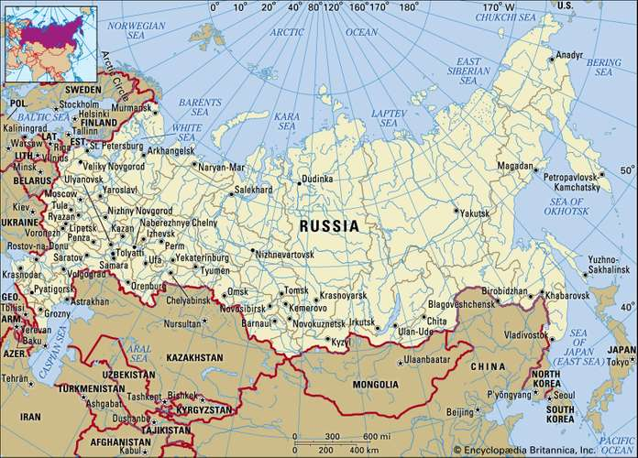
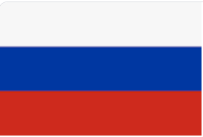
Russia is the _______ country in the world.

Slide 3
Canada is the ____ largest country in the world.

Slide 4
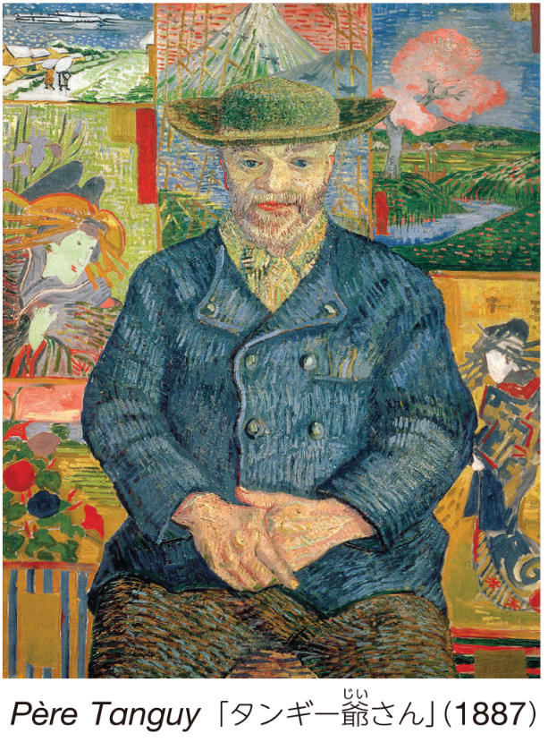
Who painted this picture ?

Slide 5
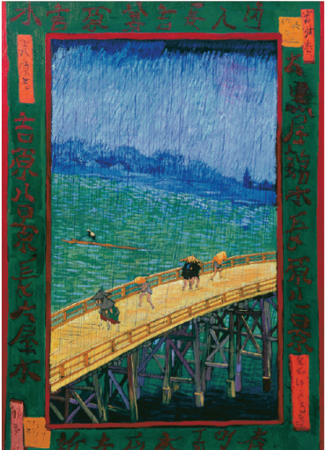
When was this picture painted ?

Slide 6
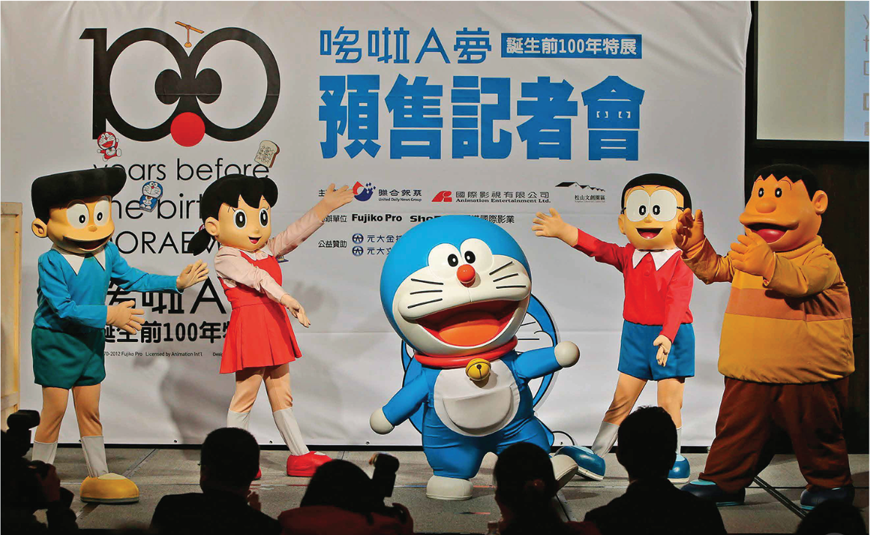
What is the nickname of this girl ?

Slide 7
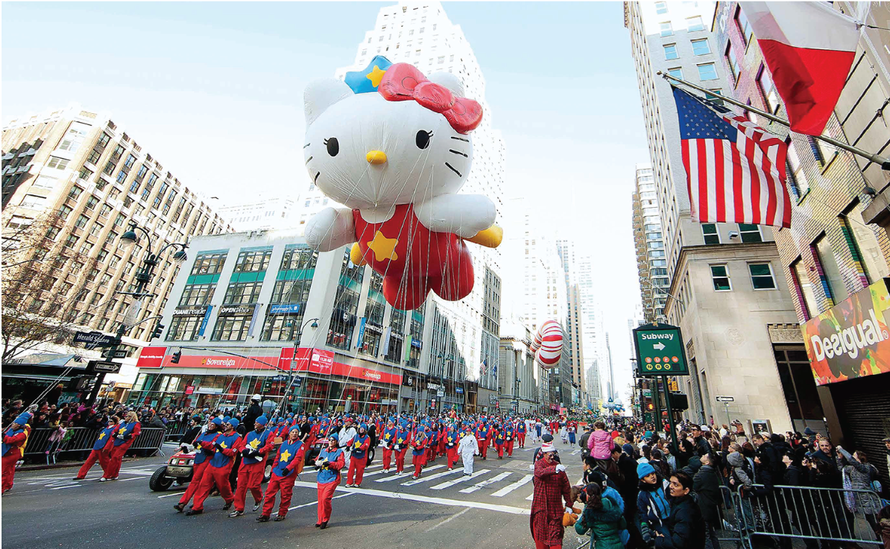
Where was this festival held ?

Slide 8
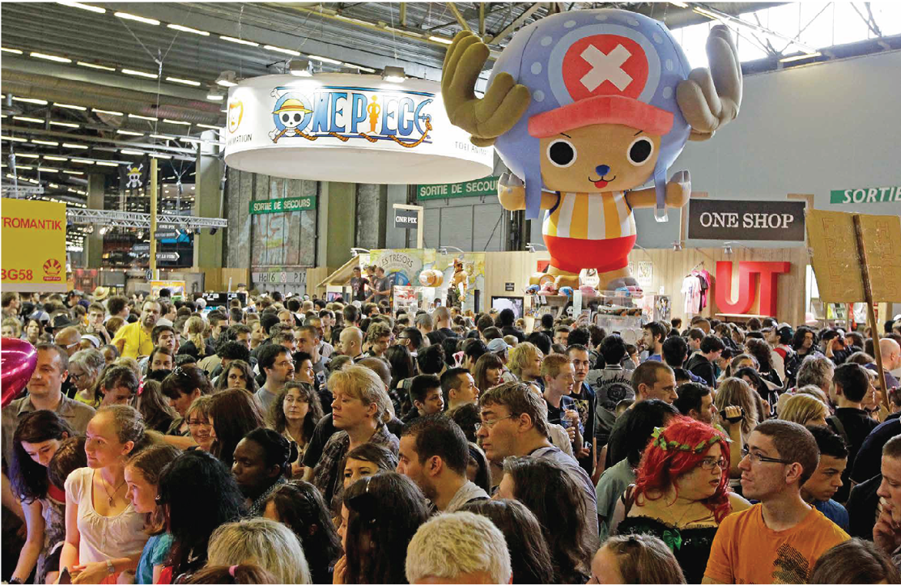
How many people visit ‘Japan EXPO’ in Paris?

Slide 9
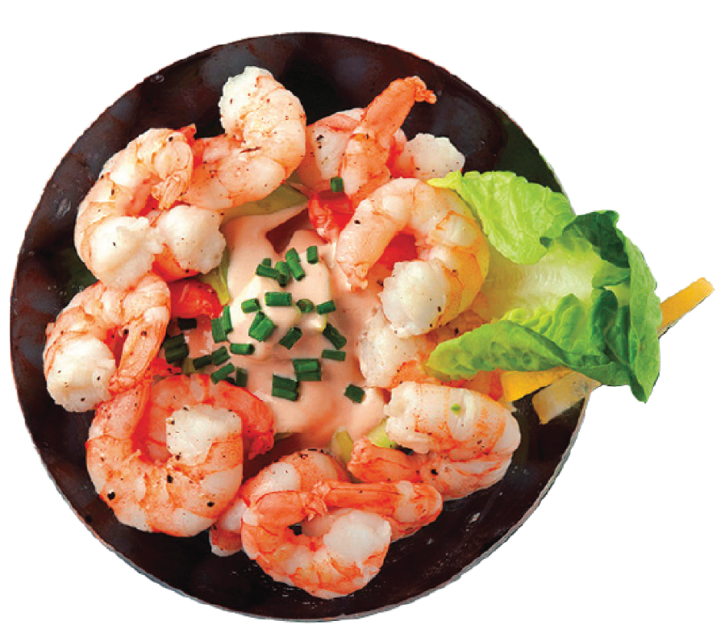
What is this ?

Slide 10
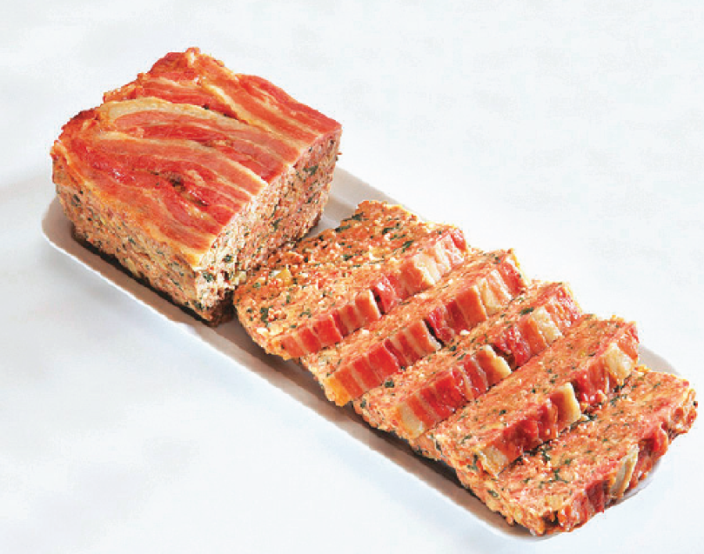
Meatloaf is made ______ beef.

Slide 11
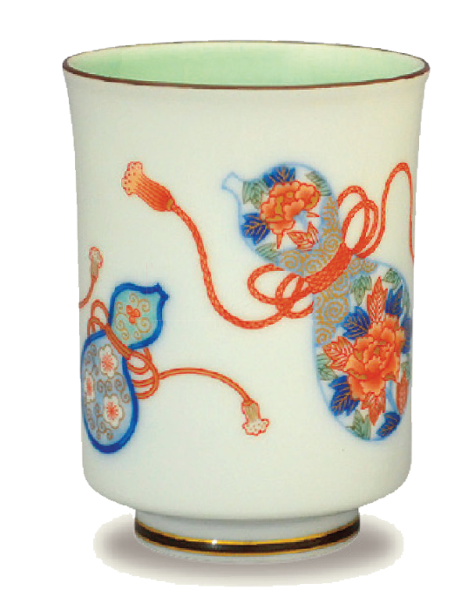
This is ______ a yunomi.

Slide 12
Who is she?

Slide 13
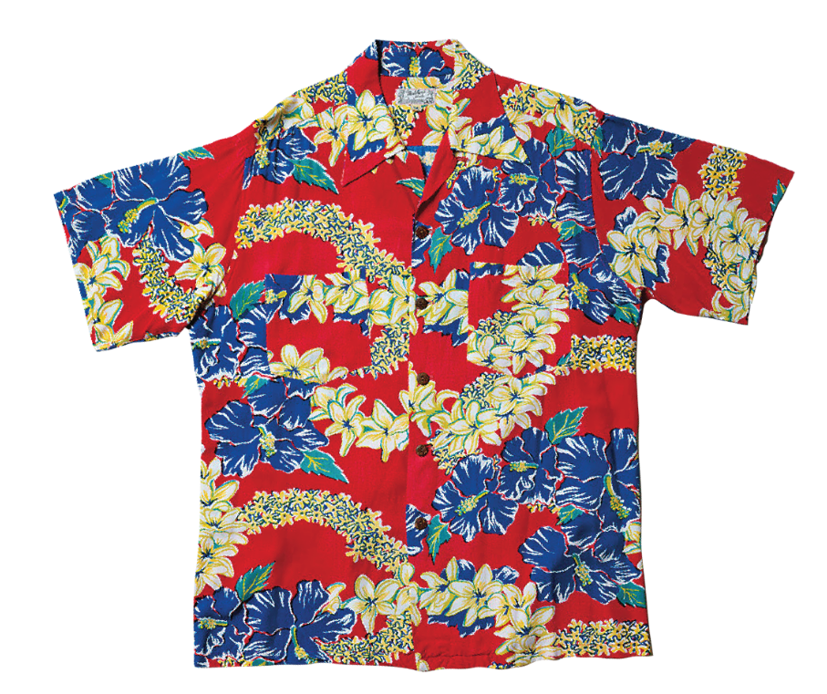
Aloha shirts are made from Japanese _______.

Slide 14
Aloha shirts are __________ as examples of Hawaiian __________.

Slide 15
A furoshiki is used when you _______ things.

Slide 16
Hinamatsuri is held in ________.

Slide 17
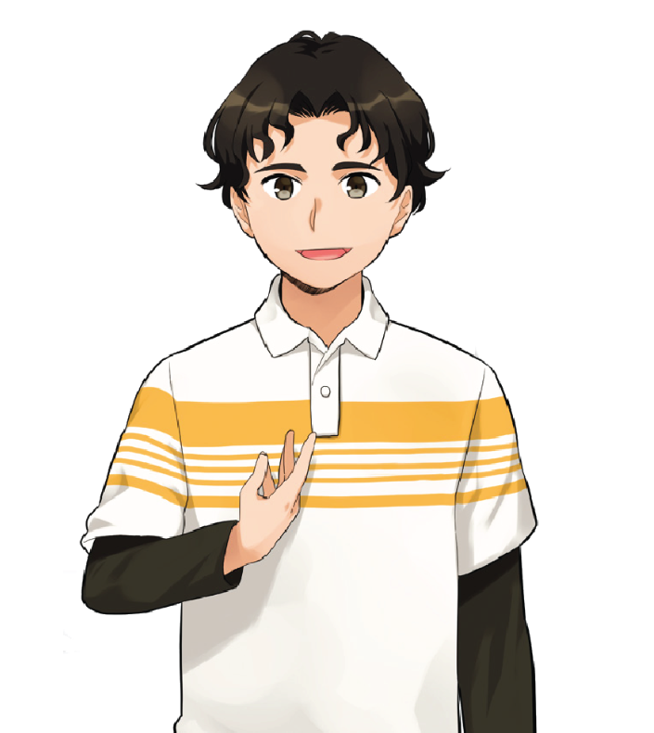
How long has Ricardo lived in Japan?

Slide 18
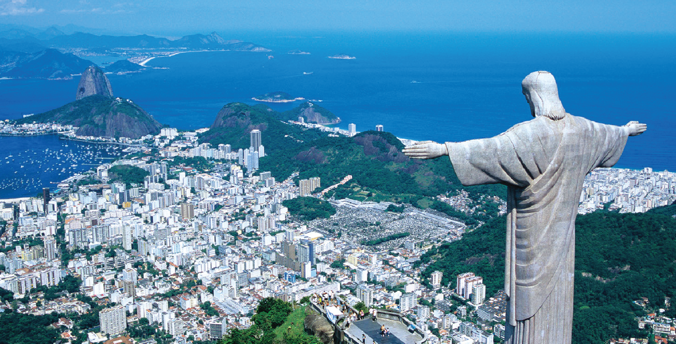
Rio de Janeiro is _______ for the Carnival.

Slide 19
How many people live in Rio de Janeiro?

Slide 20
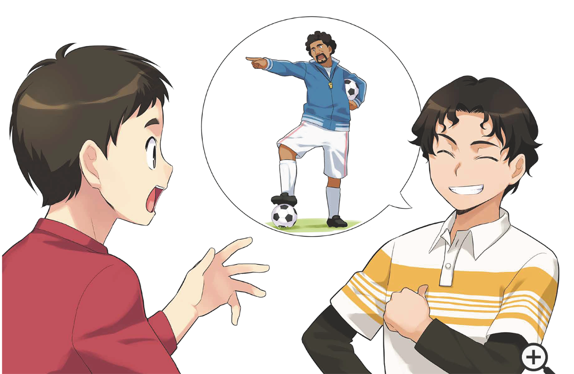
What are they talking about?

Slide 21
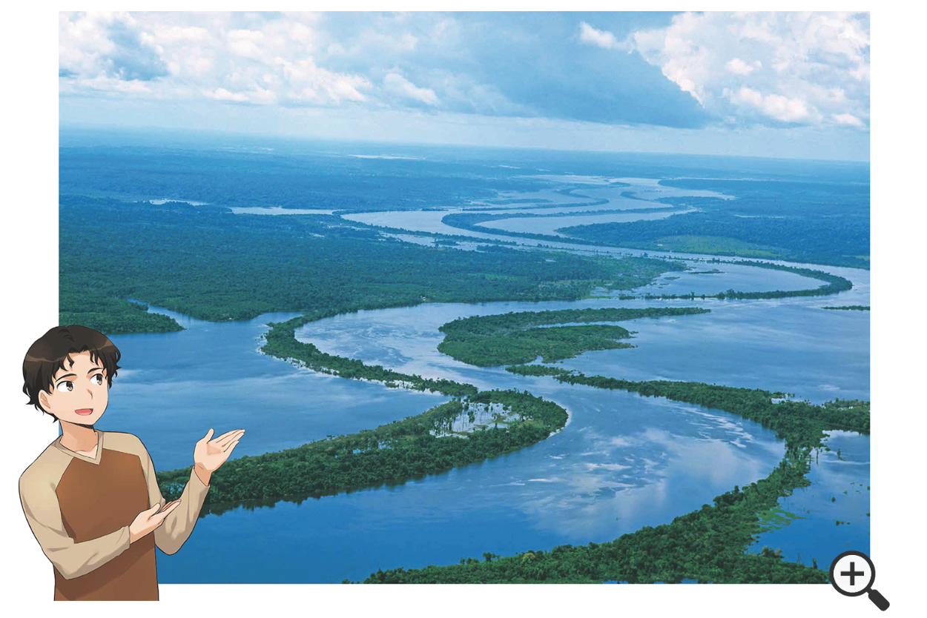
What is he talking about?

Slide 22
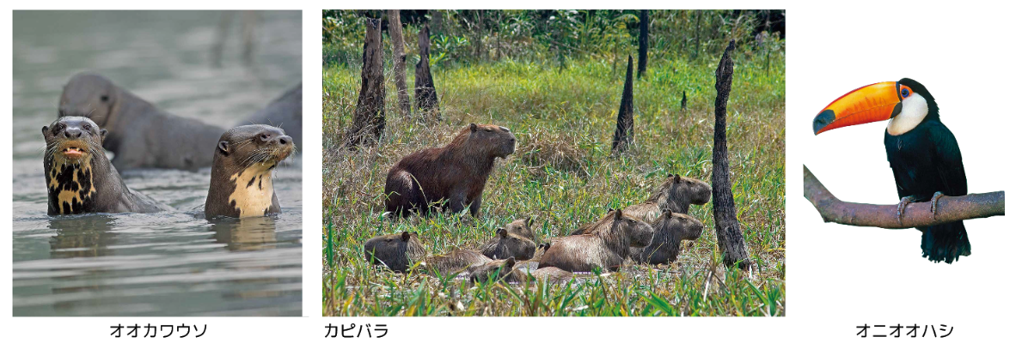
Where do they live?

Slide 23
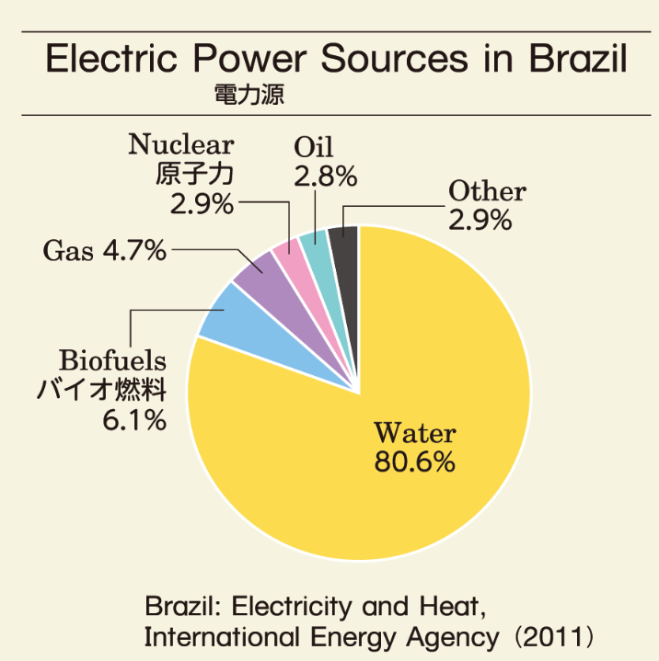
What is this?

Slide 24
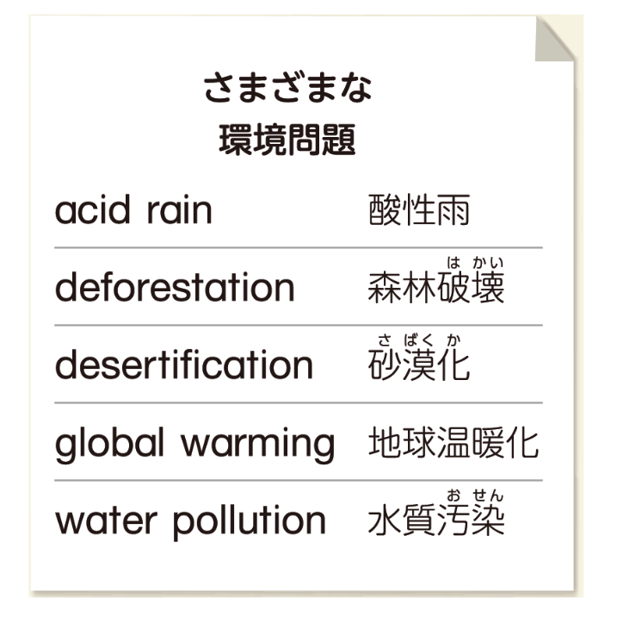
What is this?

