Slide 1
New Horizon 3 Review ❷
2021 January

Slide 2
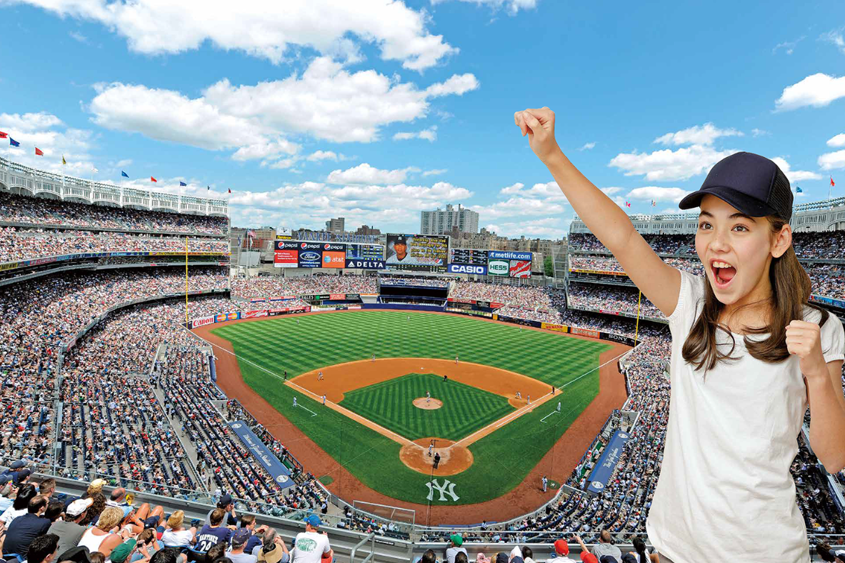
Where was she ?

Slide 3
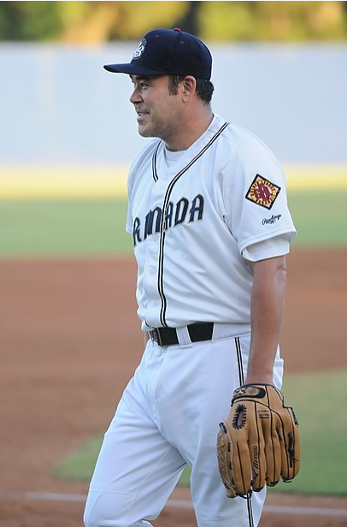
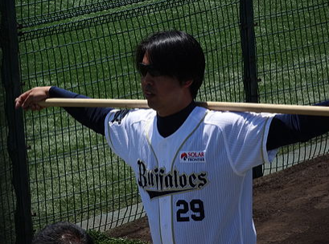
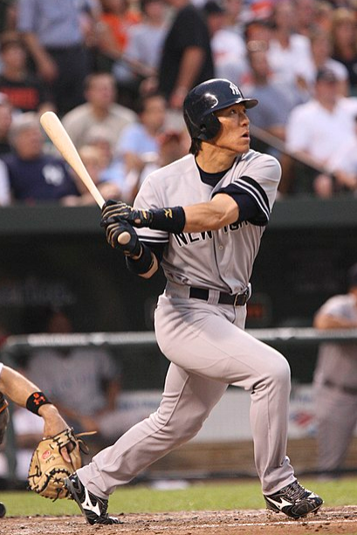
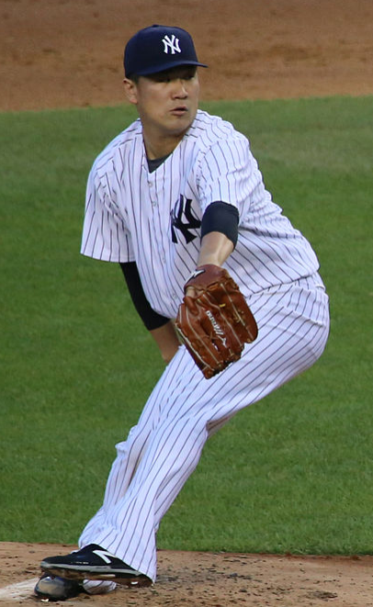
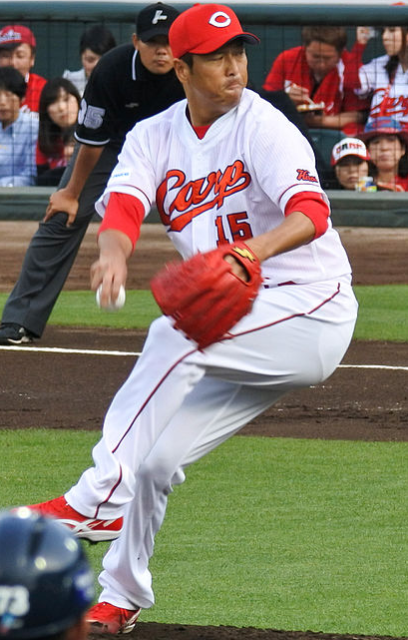
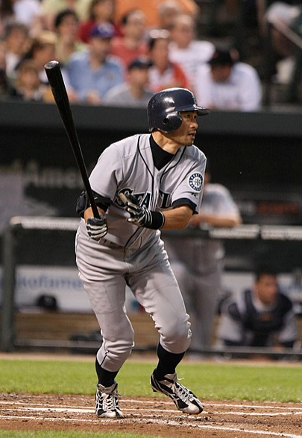
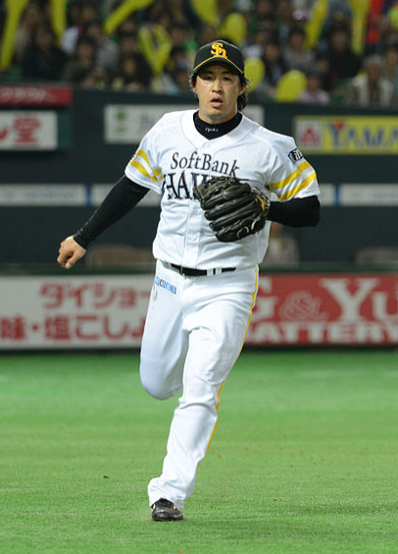
Who played in New York Yankees?

Slide 4
Have you ever heard of ‘fair trade’?

Slide 5
Have you ever bought fair trade products?

Slide 6
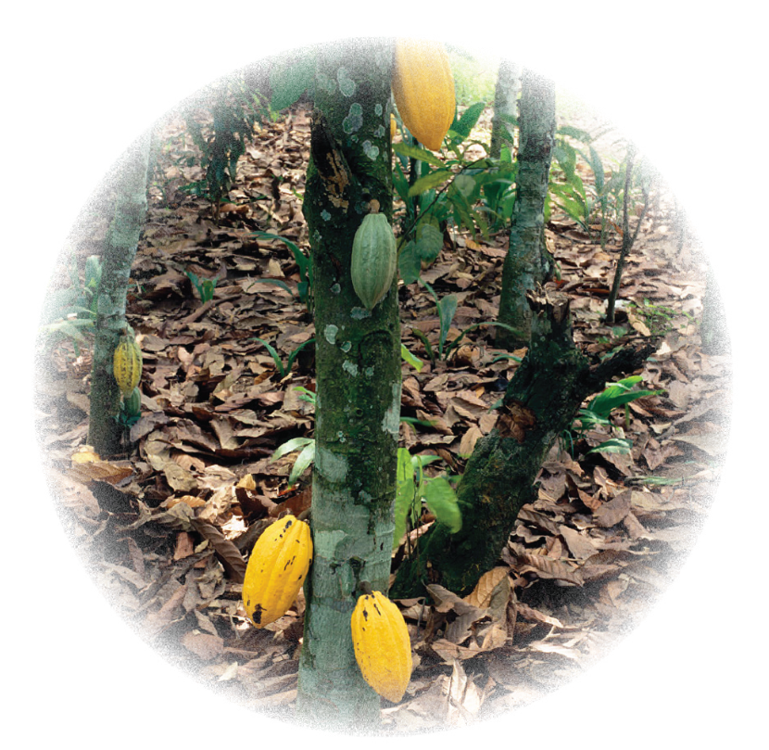
What kind of tree is this?

Slide 7
What is she doing?

Slide 8
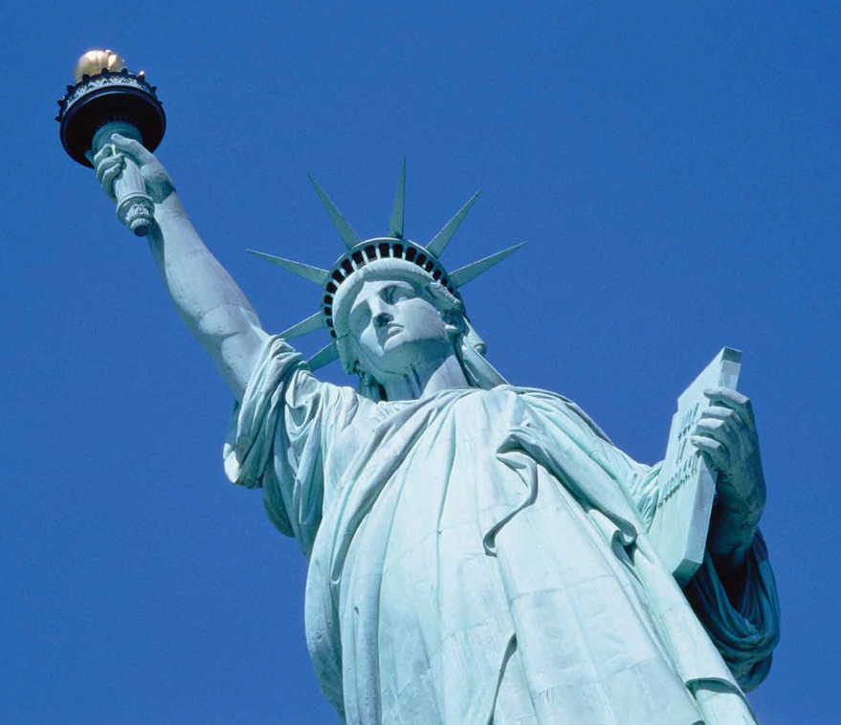
What are they talking about?

Slide 9
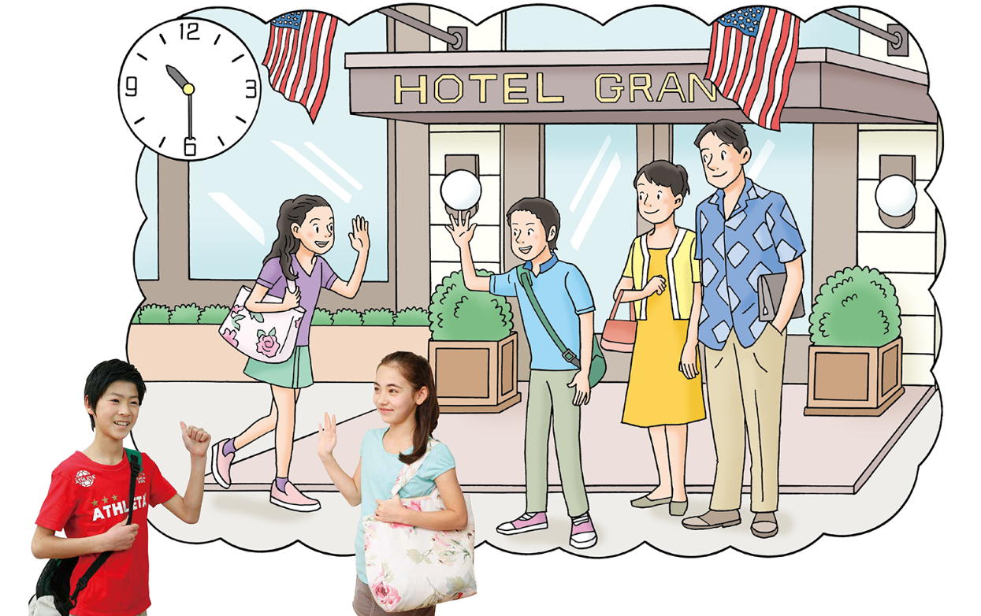
Where will they meet?

Slide 10
What time will they meet?

Slide 11
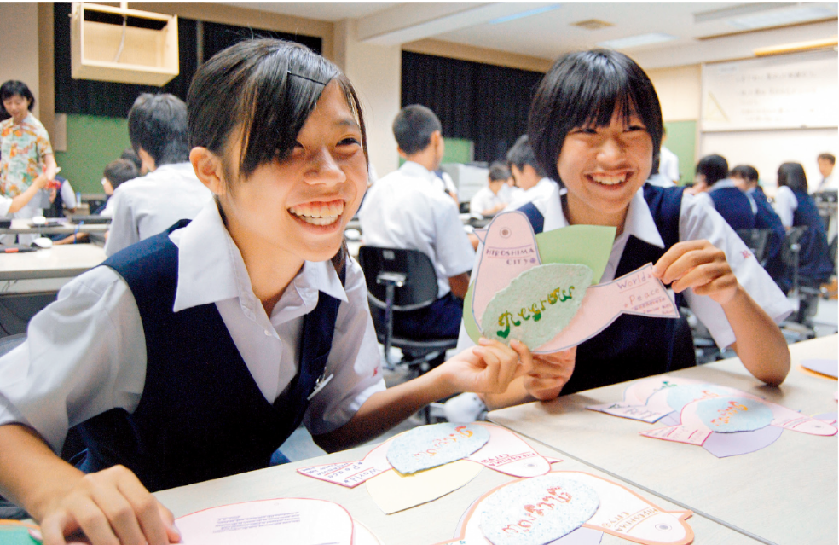
What are they doing?

Slide 12
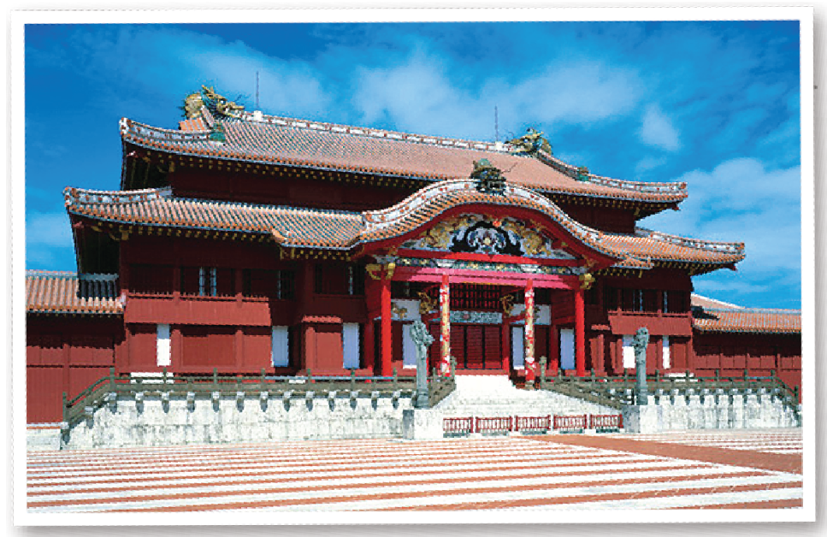
Are you interested in Okinawa’s history?

Slide 13
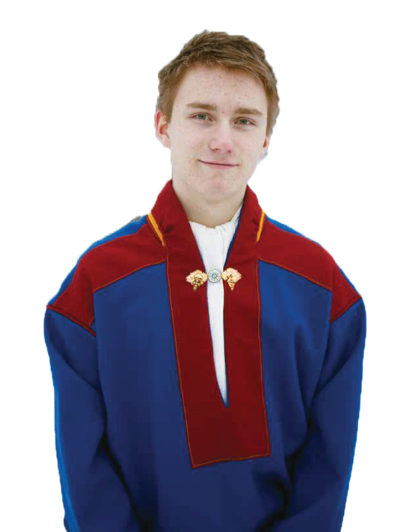
Who is he?

Slide 14
Where does he live?

Slide 15
How long has he lived in Helsinki?

Slide 16
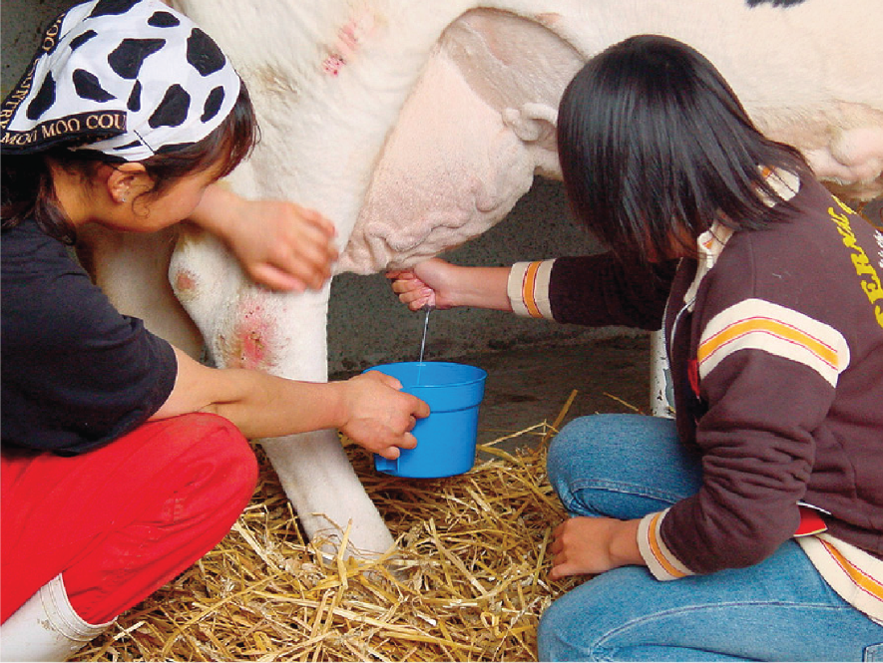
What are they doing?

Slide 17
________ Drill

Slide 18
________ Drill

Slide 19
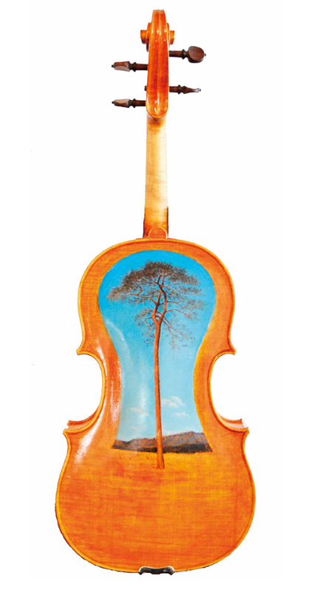
Who made “Tsunami violin”?

Slide 20
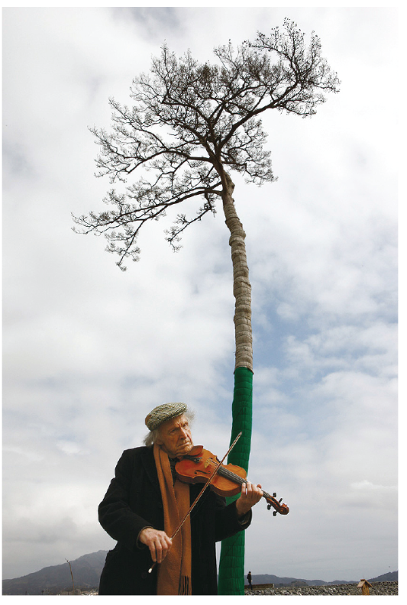
Where is this?

Slide 21
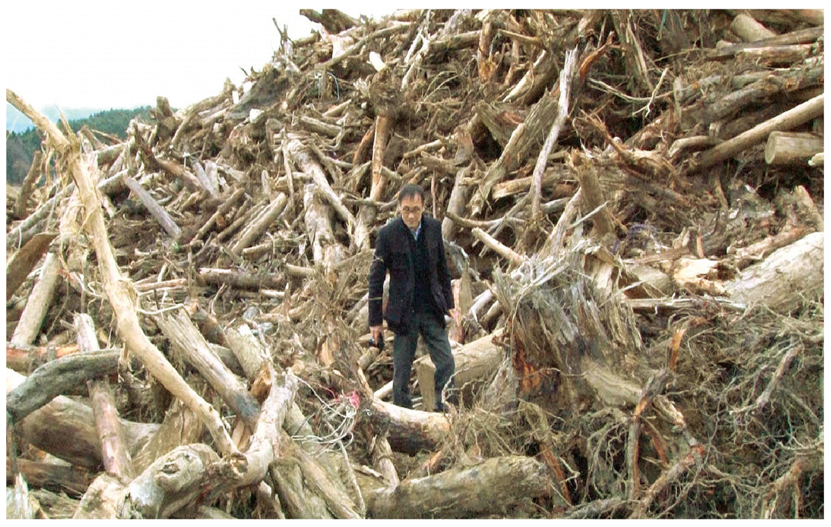
What are they?

Slide 22
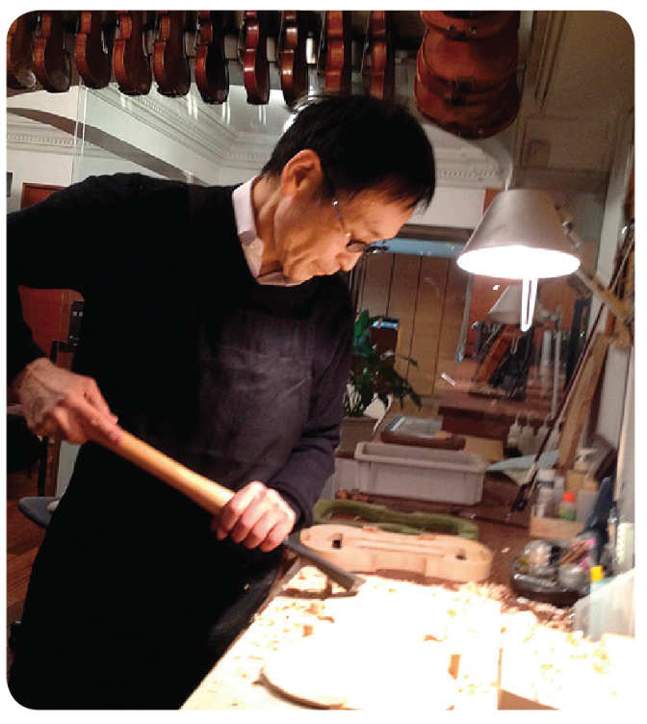
What is he doing?

