Slide 1
CALL A B
A を B と 呼ぶ

Slide 2
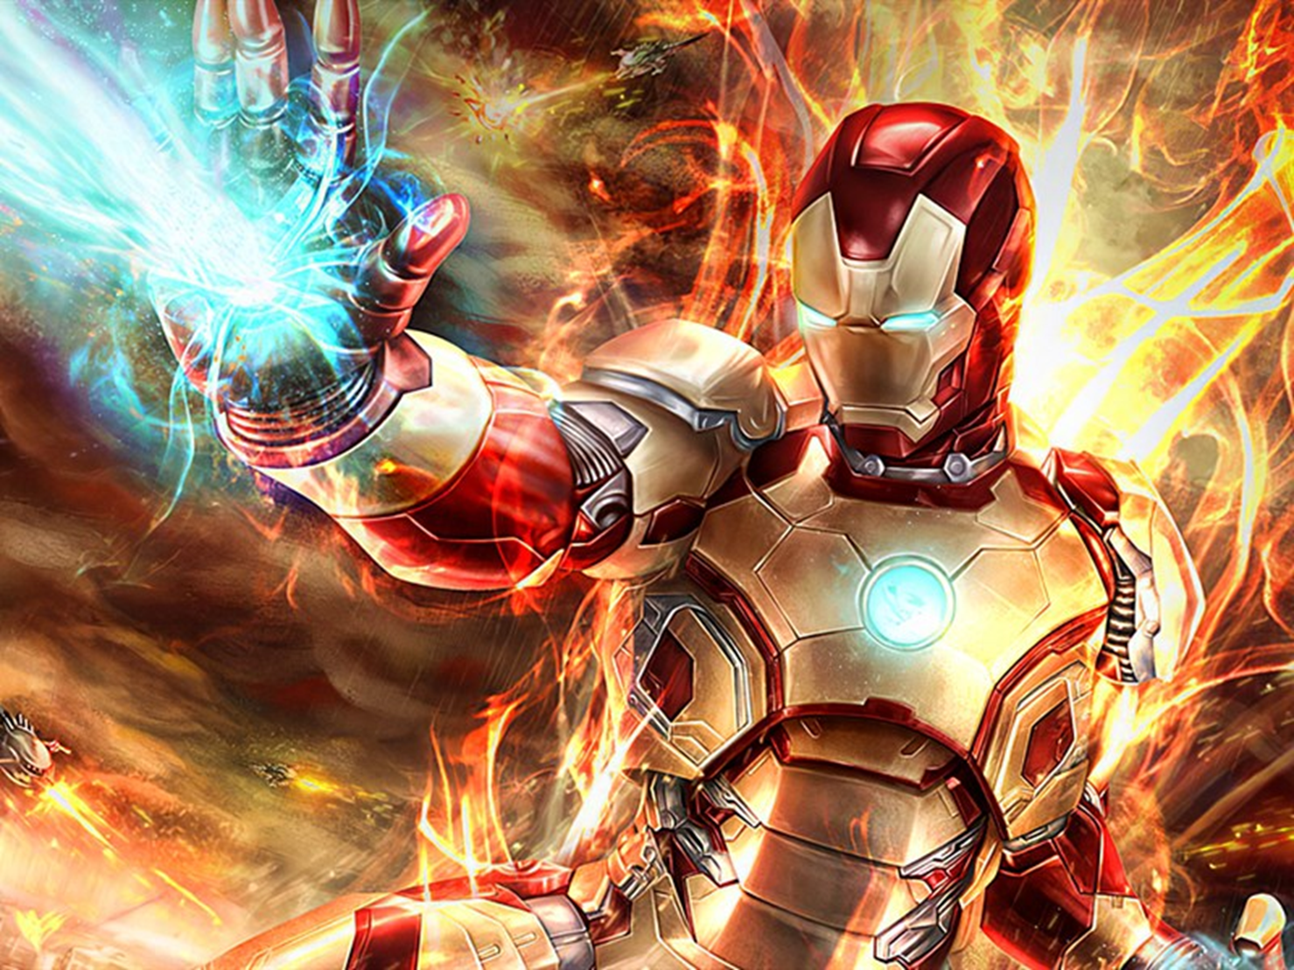
We call him IRONMAN.

Slide 3
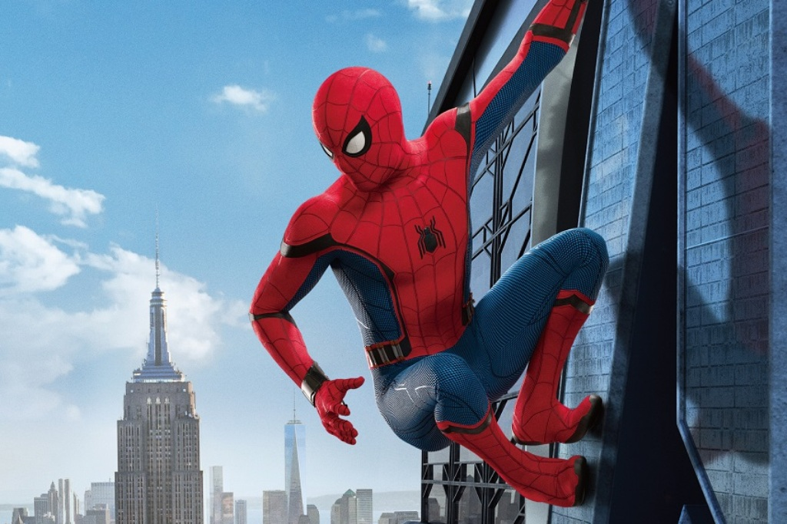
We call him _____________.

Slide 4
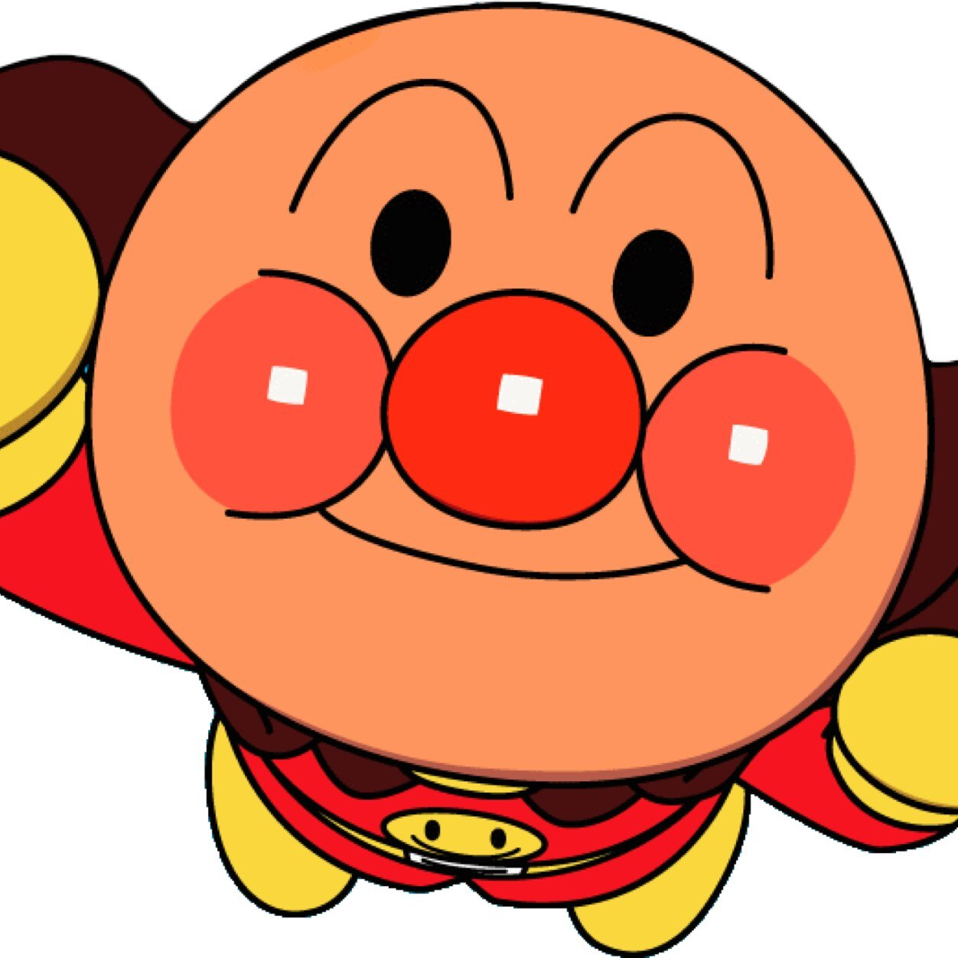
We call him _____________.

Slide 5
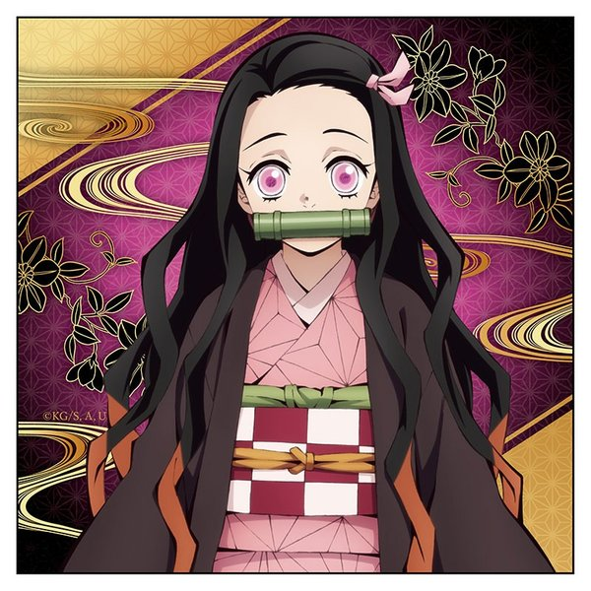
We call ____ _____________.

Slide 6
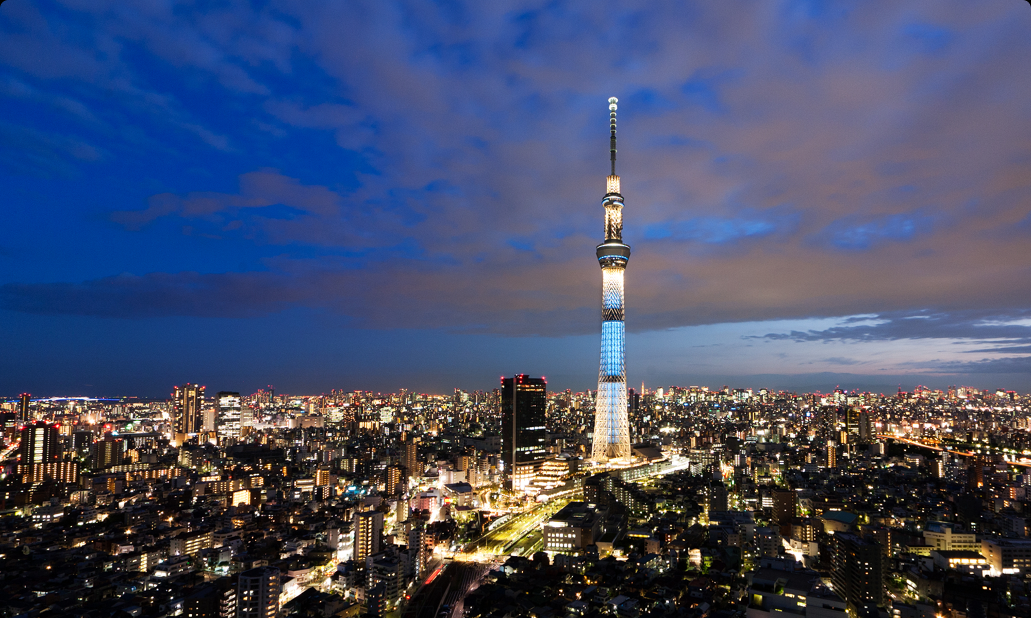
We call ____ _____________.

Slide 7
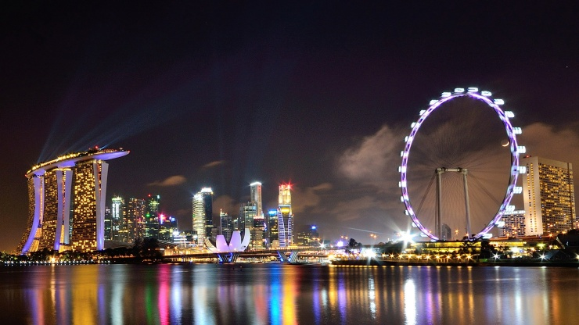
We call ____ _____________.

Slide 8
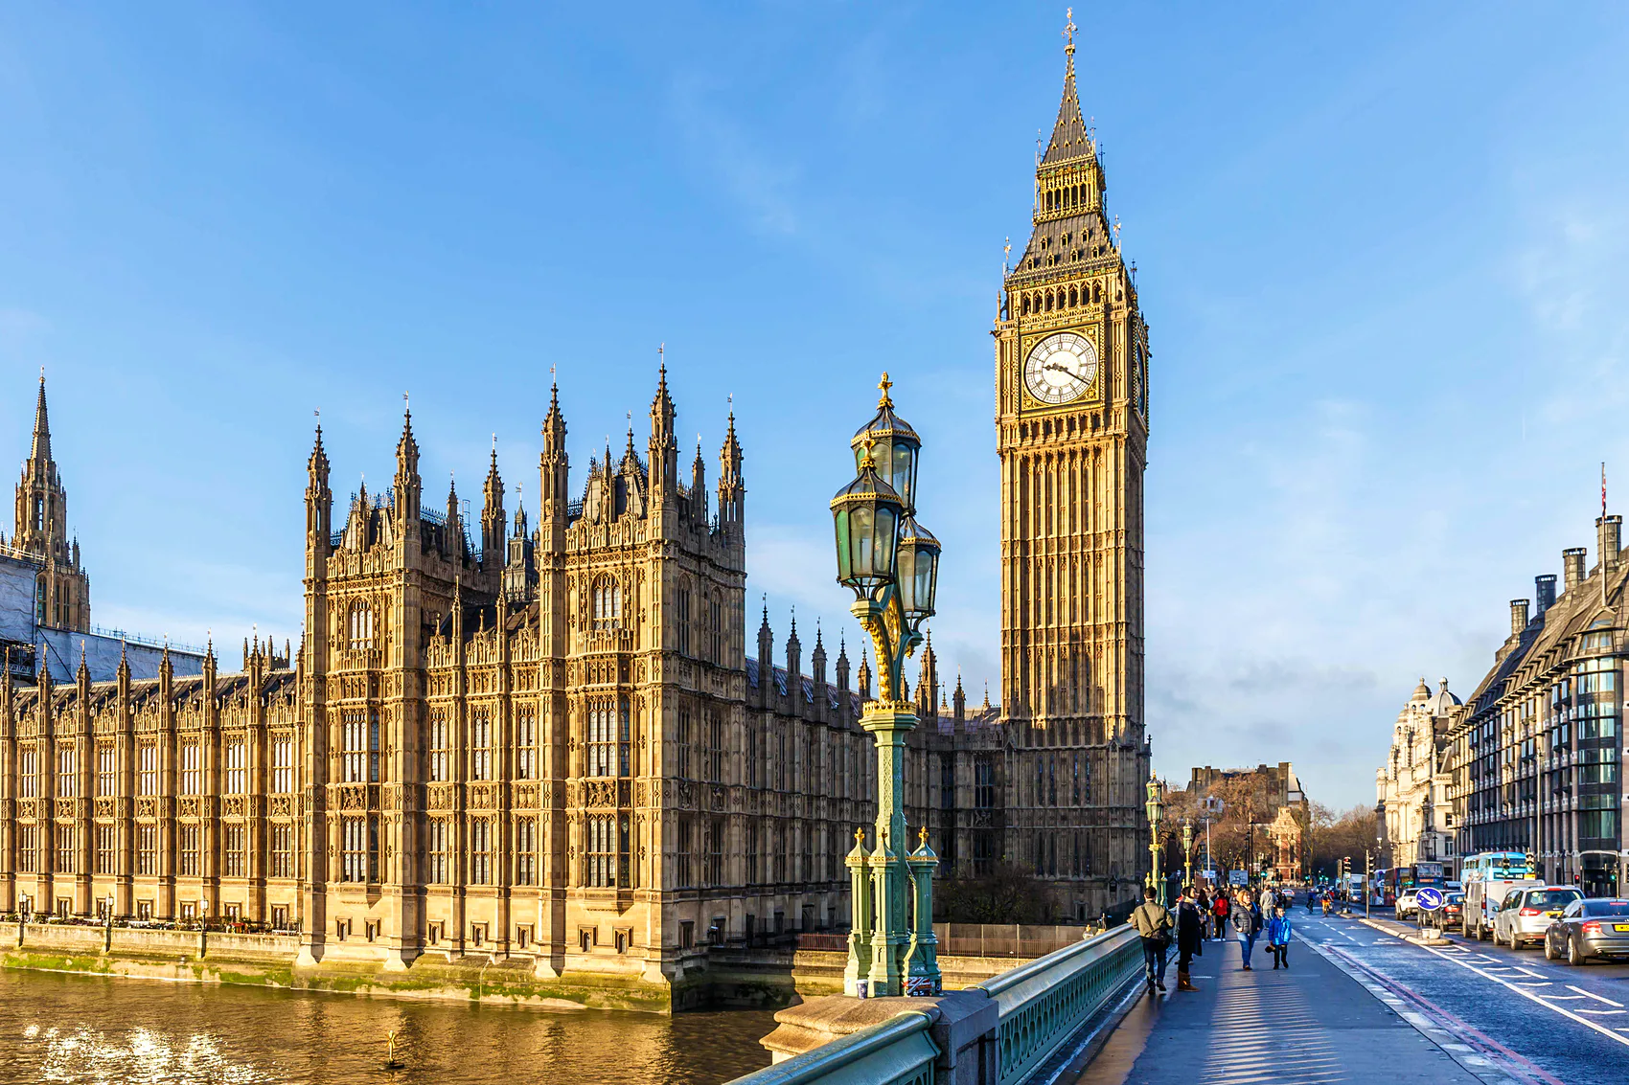
We call ____ _____________.

Slide 9
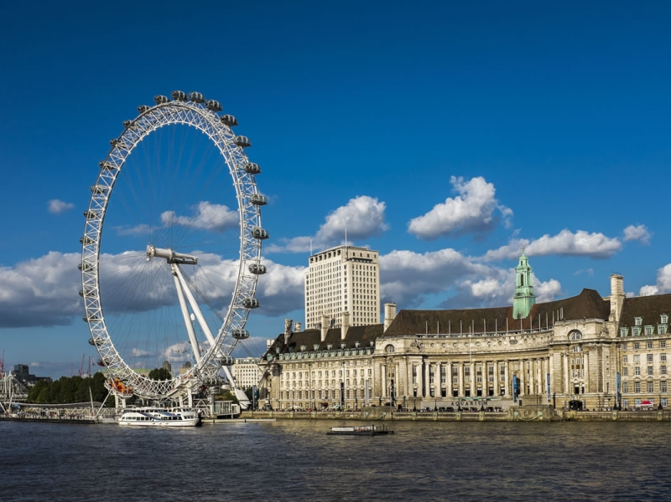
We call ____ _____________.

Slide 10
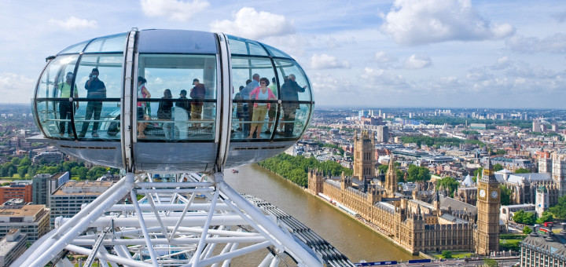
We call ____ _____________.

Slide 11
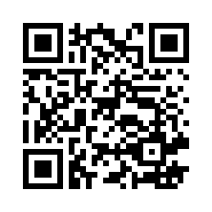
Visit Singapore!
https://www.visitsingapore.com/ja_jp/

