Slide 1
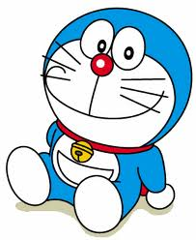
If …
もしも… の２つの世界

Slide 2
❶ If it is sunny tomorrow,
I will go fishing.
❷ If it were sunny today,
I would go fishing.

Slide 3
❶ If it is sunny tomorrow,
I will go fishing.
❷ If it were sunny today,
I would go fishing.

Slide 4
❶ If you buy a computer,
you can surf the internet.
❷ If you had a computer now,
you could surf the internet.

Slide 5
❶ If you buy a computer,
you can surf the internet.
❷ If you had a computer now,
you could surf the internet.

Slide 6
If we had his tool
ドラえもんの道具があったら

Slide 7
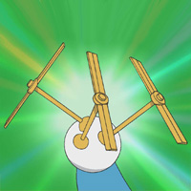
______ we had this tool,
we _______ go everywhere easily.

Slide 8
If we had this tool,
we could go everywhere easily.

Slide 9
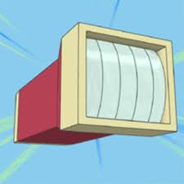
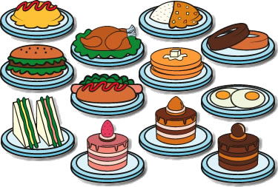
If we had this tool,
we _____ enlarge
for starving people.

Slide 10
If we had this tool,
we would enlarge
for starving people.

Slide 11
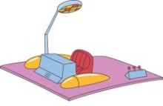
If we had this tool,
we could ________our future.

Slide 12
If we had this tool,
we could know our future.

Slide 13
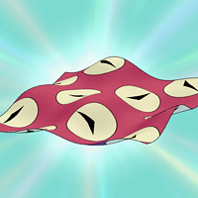
If we had this tool,
we could _______ everything.

Slide 14
If we had this tool,
we could fix everything.

Slide 15
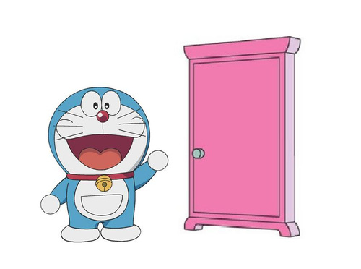
If we had this tool,
we could ______ everywhere.

Slide 16
If we had this tool,
we could visit everywhere.

Slide 17
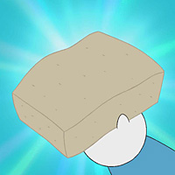
If we had this tool,
we ______________ study
foreign languages.

Slide 18
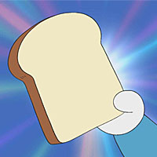
If we had this tool,
we _____________ study hard.

Slide 19
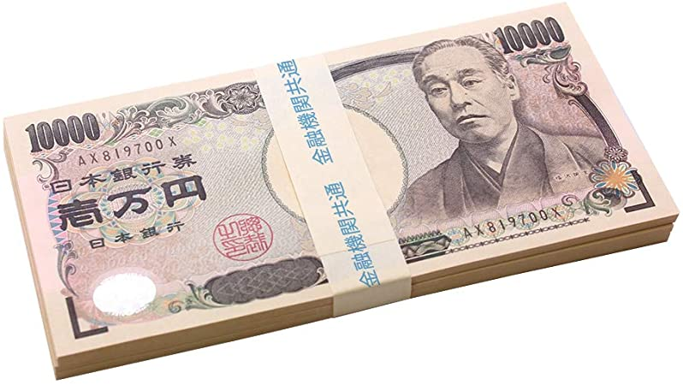
If you had one million yen,
what would you do?

