Slide 1
Let’s Talk 2
Offer

Slide 2
Q：対話の流れがスムーズになるように（ ）に適切な表現を下から 選んで書きなさい。
A: Excuse me. Can I help you?
B: Oh, yes, please. ( )
A: Midori City Hotel? Yes. ( )
B: Thank you. ( )
A: Would you like me to carry your umbrella or something?
B: Oh. Thank you very much.
・Shall I take you there?
・That’s very kind of you.
・Do you know where Midori City Hotel is?

Slide 3
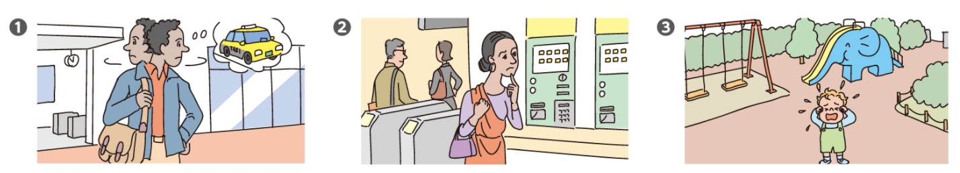
Q：No.1 ～ No.3 の対話は下の❶❷❸のどの場面のものですか。
No.1 ( ) No.2 ( ) No.3 ( )

Slide 4
何かお手伝いしましょうか？
Can I
help you?

Slide 5
手伝ってくれませんか？
Can you
help me?

Slide 6
そこまでお連れしましょうか？
Shall I
take you there?

Slide 7
そこまで一緒に行きましょうか？
Shall we
go there?

Slide 8
傘をお持ちしましょうか？
Would you like me to carry your umbrella?

Slide 9
(自分の）傘を持ちたいですか？
Would you like to carry
your umbrella?

Slide 10
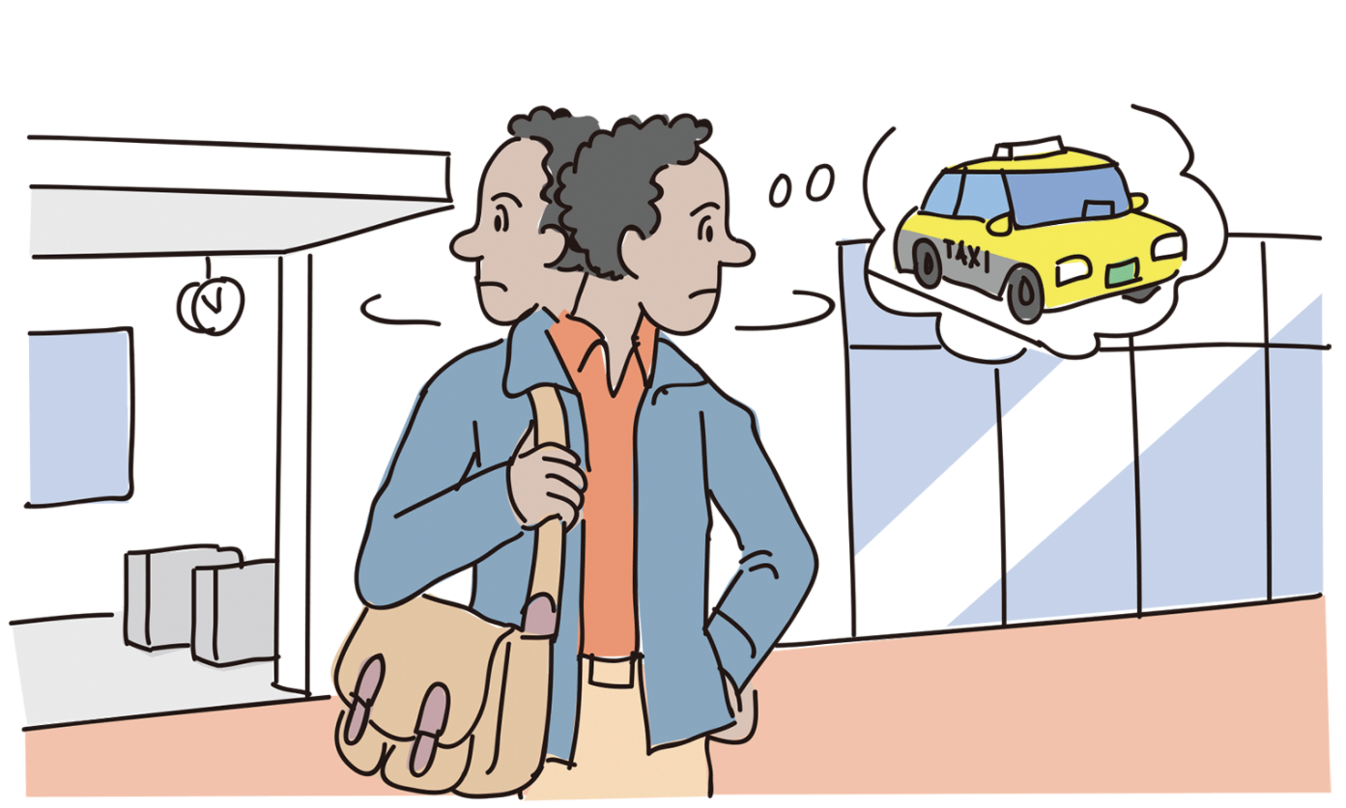
Let’s practice! ❶
A: Excuse me. Can I help you?
B: Oh, yes, please. Could you tell me where I can get a taxi?
A: Sure. Shall I take you there?
B: Oh, thank you.

Slide 11
Let’s try! ❶
A: Excuse me. Can I help you?
B: Oh, yes, please.
どこでタクシーに乗れるか教えてくれませんか。
A: Sure. そこまで連れて行ってあげましょうか。
B: Oh, thank you.

Slide 12
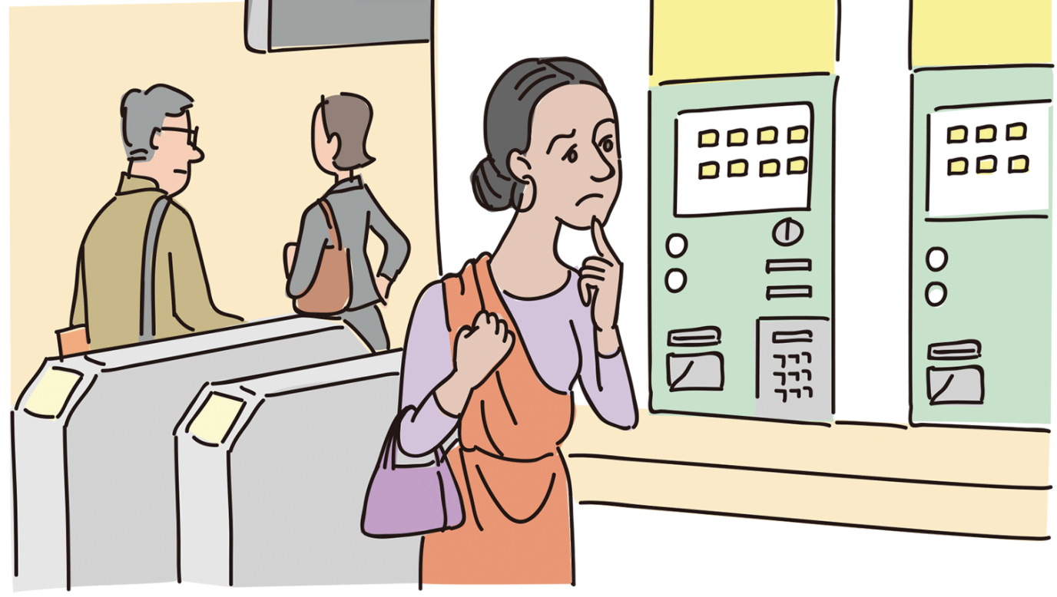
Let’s practice! ❷
A: Excuse me. Do you need some help?
B: Yes, please.
Could you help me buy a ticket?
A: Of course.
Where would you like to go?
B: I’d like to go to Wakaba Station.

Slide 13
Let’s try! ❷
A: Excuse me. Do you need some help?
B: Yes, please.
切符を買うのを手伝ってくれませんか。
A: Of course.
どこに行きたいのですか。
B: I’d like to go to Wakaba Station.

Slide 14
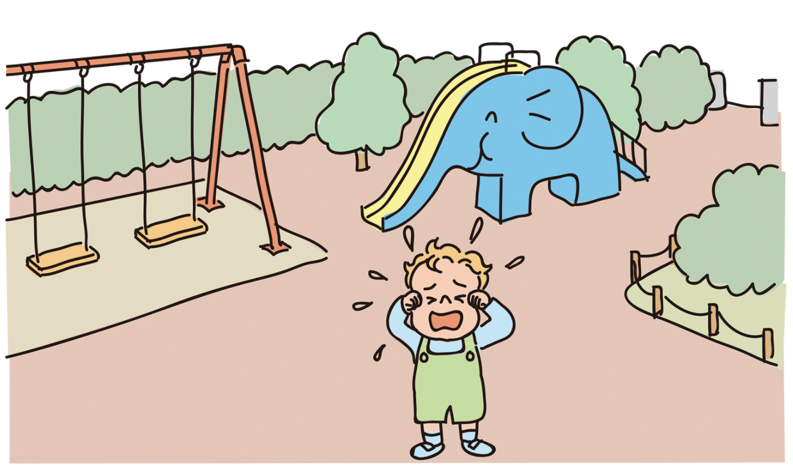
Let’s practice! ❸
A: Hi. What’s wrong? Are you lost?
B: Yes….
A: Where are your mom and dad?
B: I don’t know.
A: OK. I’ll take you to the police station. Can you walk?
B: Yes.

Slide 15
Let’s try! ❸
A: Hi. どうしたの？ Are you lost?
B: Yes….
A: Where are your mom and dad?
B: I don’t know.
A: OK. 警察まで連れて行ってあげるよ。
歩ける？
B: Yes.

Slide 16
A: Excuse me. Can I help you?
B: Oh, yes, please. Do you know where Midori City Hotel is?
A: Midori City Hotel? Yes. Shall I take you there?
B: Thank you. That’s very kind of you.
A: Would you like me to carry your umbrella or something?
B: Oh. Thank you very much.

Slide 17
A: Excuse me. Can I help you?
B: Oh, yes, please. Do you know where Midori City Hotel is?
A: Midori City Hotel? Yes. Shall I take you there?
B: Thank you. That’s very kind of you.
A: Would you like me to carry your umbrella or something?
B: Oh. Thank you very much.

