Slide 1
C
What is this ? Each answer starts “C.”

Slide 2
to telephone someone
call

Slide 3
to decide which things
or people you want
choose

Slide 4
an electronic machine
that help you find information and store information
computer

Slide 5
to prepare food
for eating by using heat
cook

Slide 6
a performance given by musicians or singers
concert

Slide 7
a member of the same class
in a school, college,
or a university
classmate

Slide 8
a sweet food made
from sugar or chocolate
candy

Slide 9
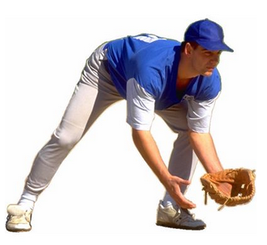
to get hold of
and stop an object
catch

Slide 10
activities that are related to
art, music, literature etc
culture

Slide 11
a piece of furniture
to sit on
chair

Slide 12
someone
who is not yet an adult
child

Slide 13
a business organization
that makes or sells
goods or services
company

Slide 14
the child of your uncle or aunt
cousin

Slide 15
Question

Slide 16
to telephone someone

Slide 17
to decide which things
or people you want

Slide 18
a electronic machine
that help you find information and store information

Slide 19
to prepare food
for eating by using heat

Slide 20
a performance given by musicians or singers

Slide 21
a member of the same class
in a school, college,
or a university

Slide 22
a sweet food made
from sugar or chocolate

Slide 23
to get hold of
and stop an object

Slide 24
activities that are related to
art, music, literature etc

