Slide 1

What is this job?

Slide 2
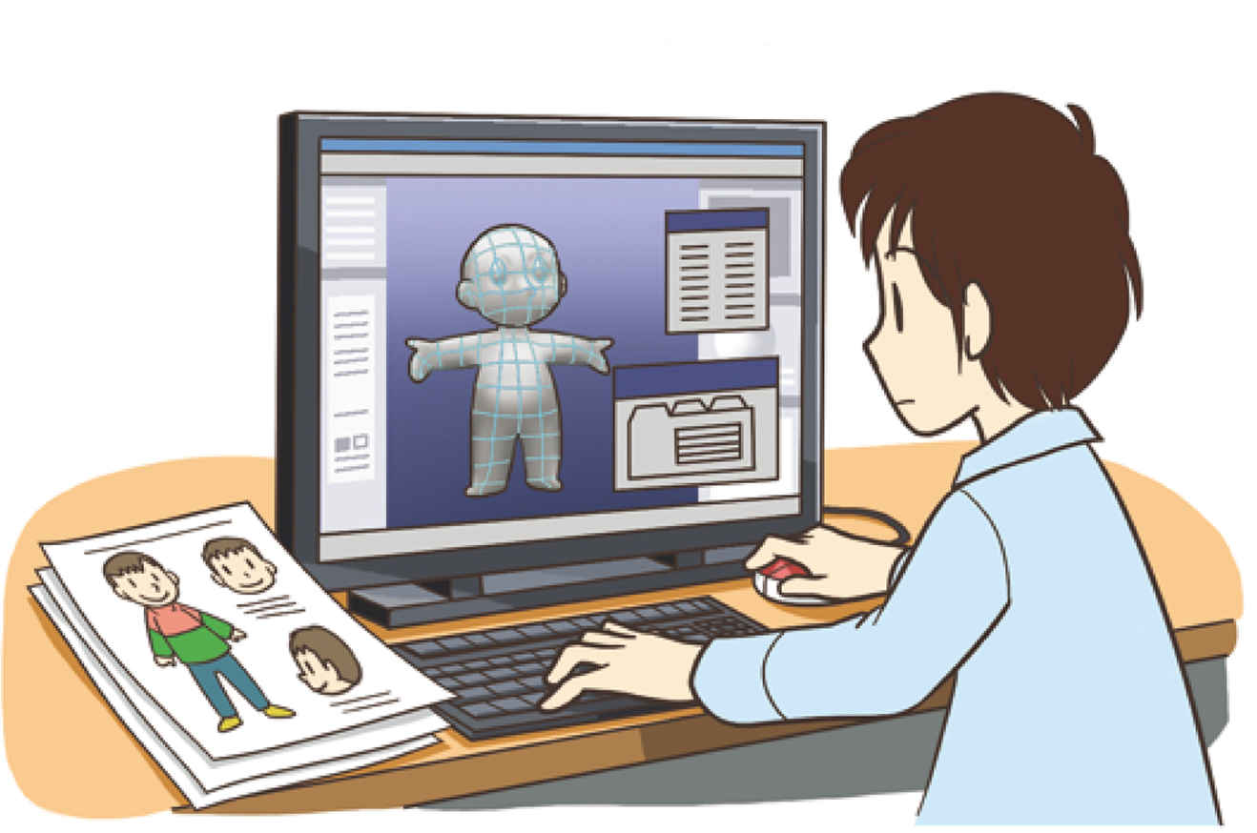

Slide 3
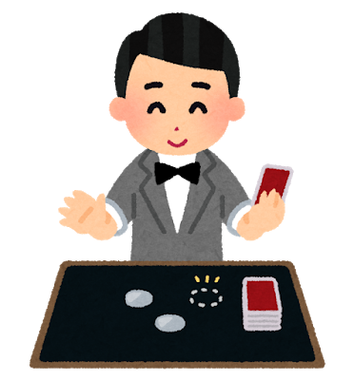

Slide 4


Slide 5
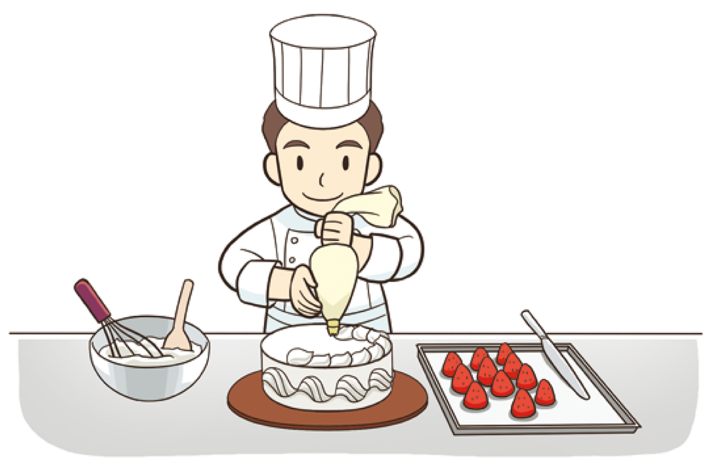

Slide 6
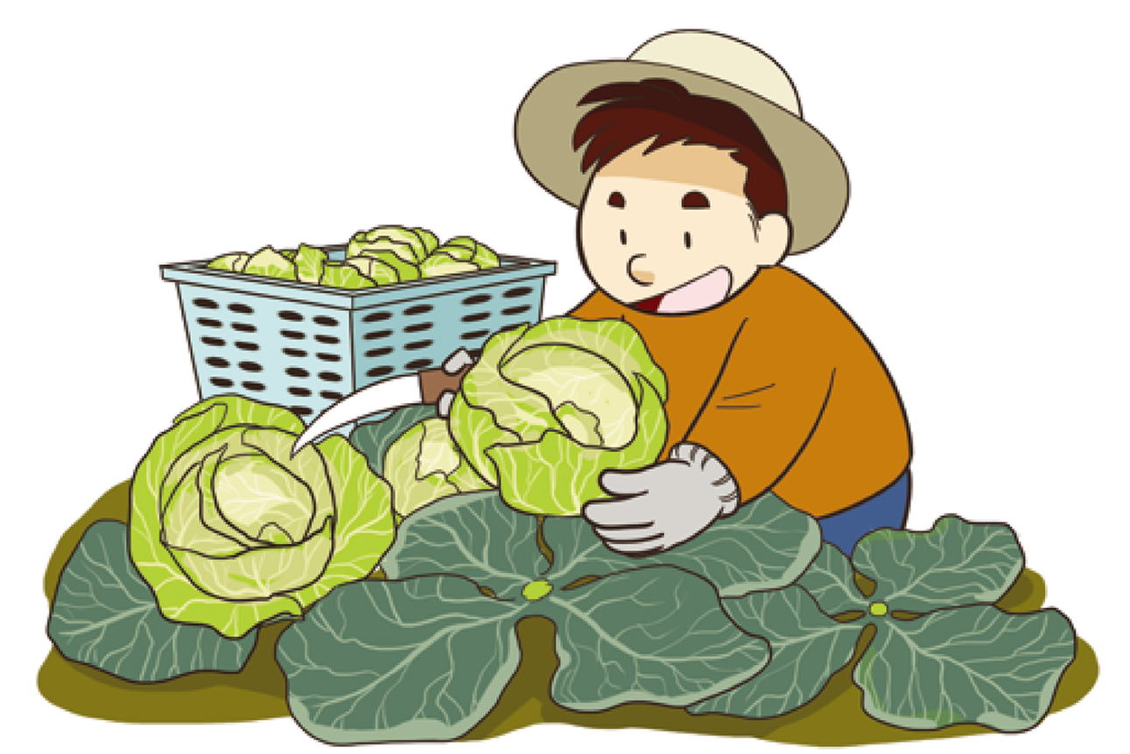

Slide 7


Slide 8
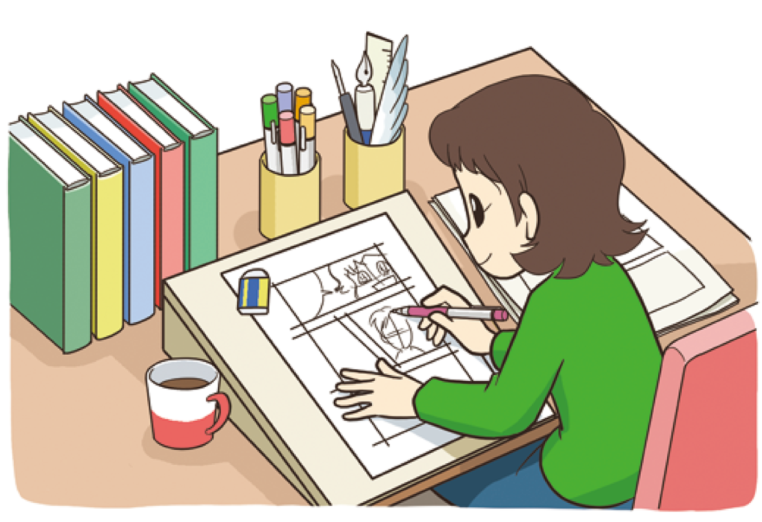

Slide 9
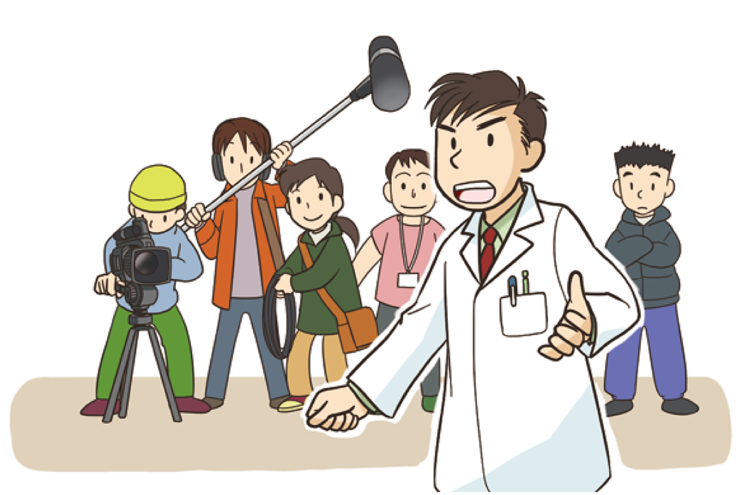

Slide 10
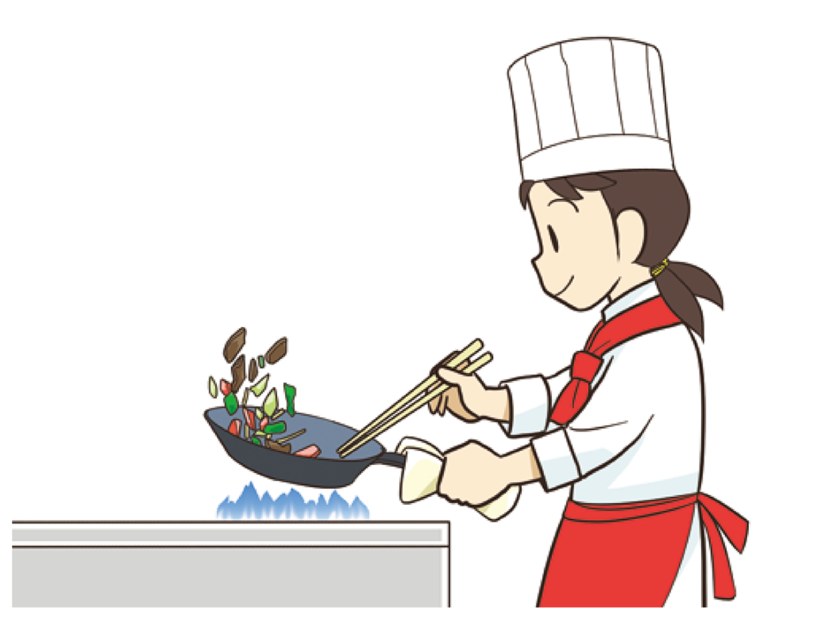

Slide 11


Slide 12
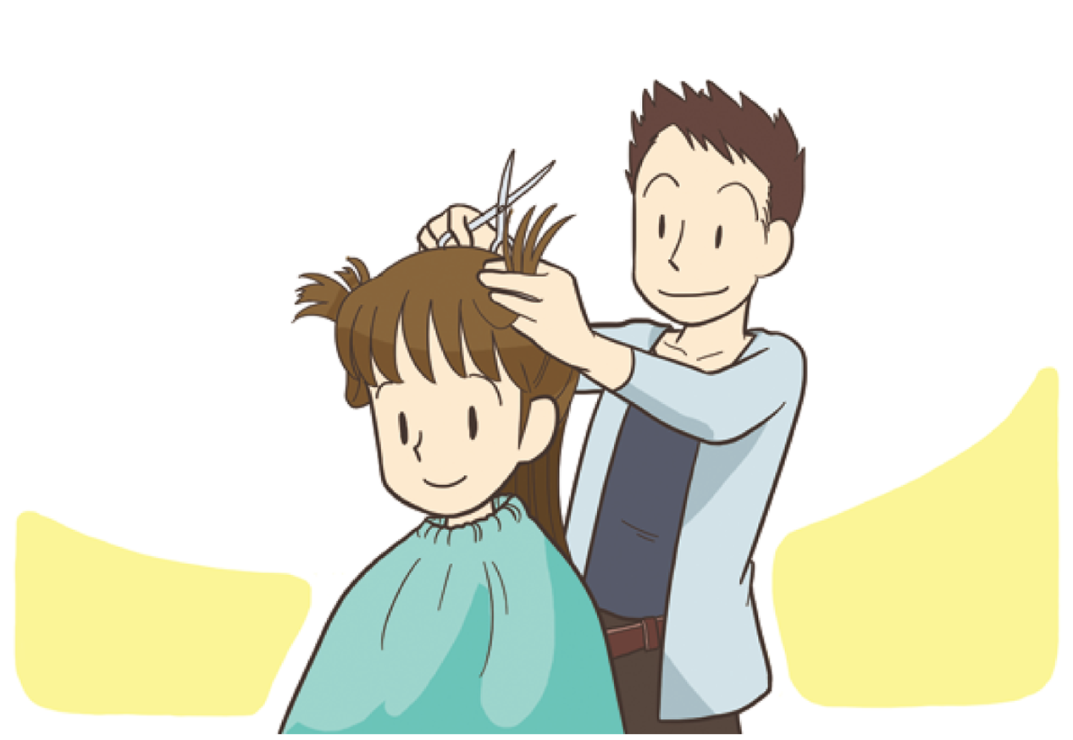

Slide 13


Slide 14
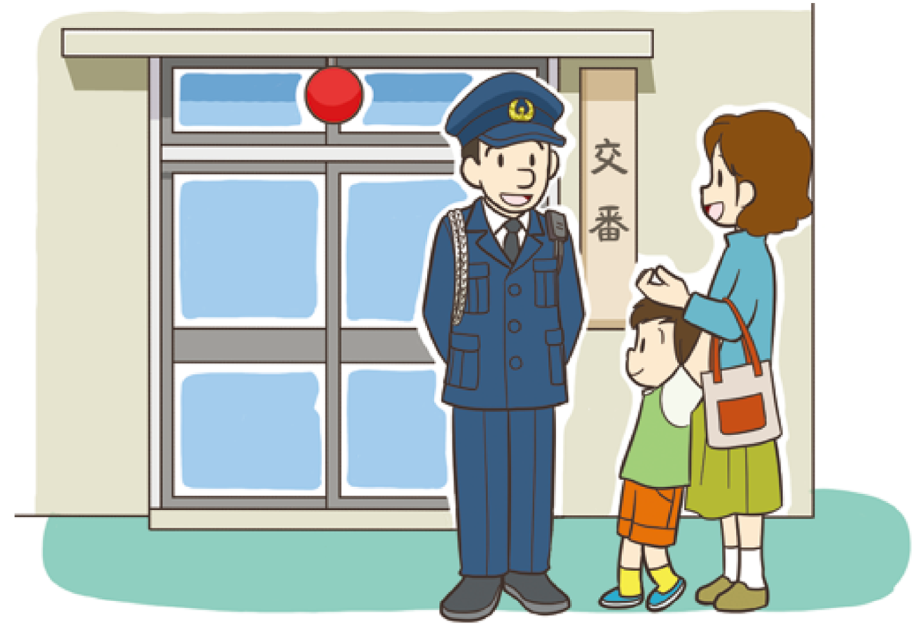

Slide 15
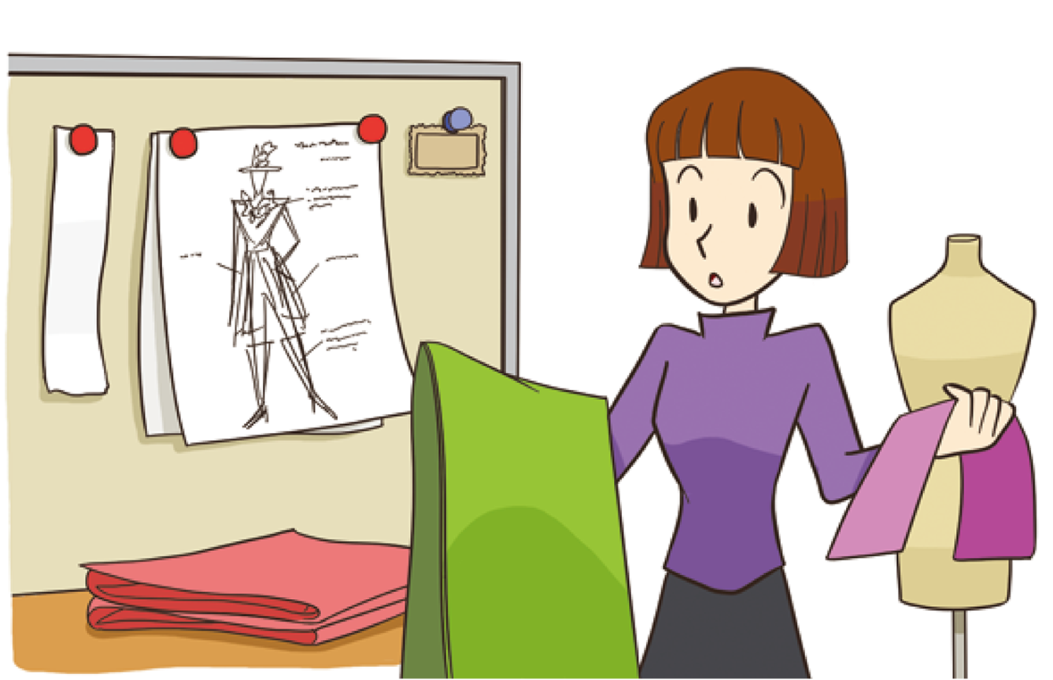

Slide 16


Slide 17


Slide 18
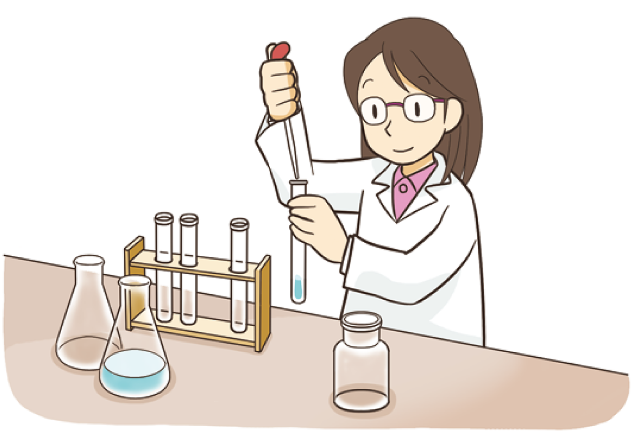

Slide 19
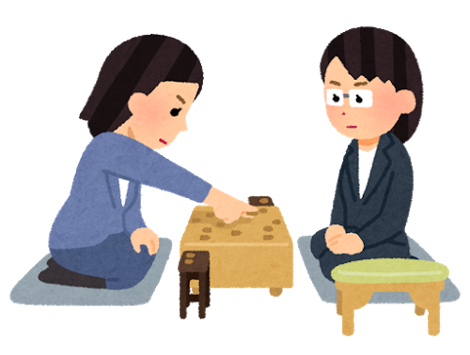

Slide 20
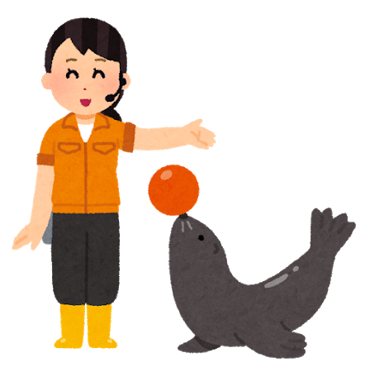

Slide 21
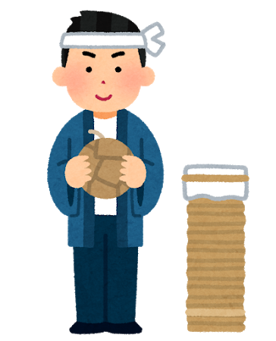

Slide 22
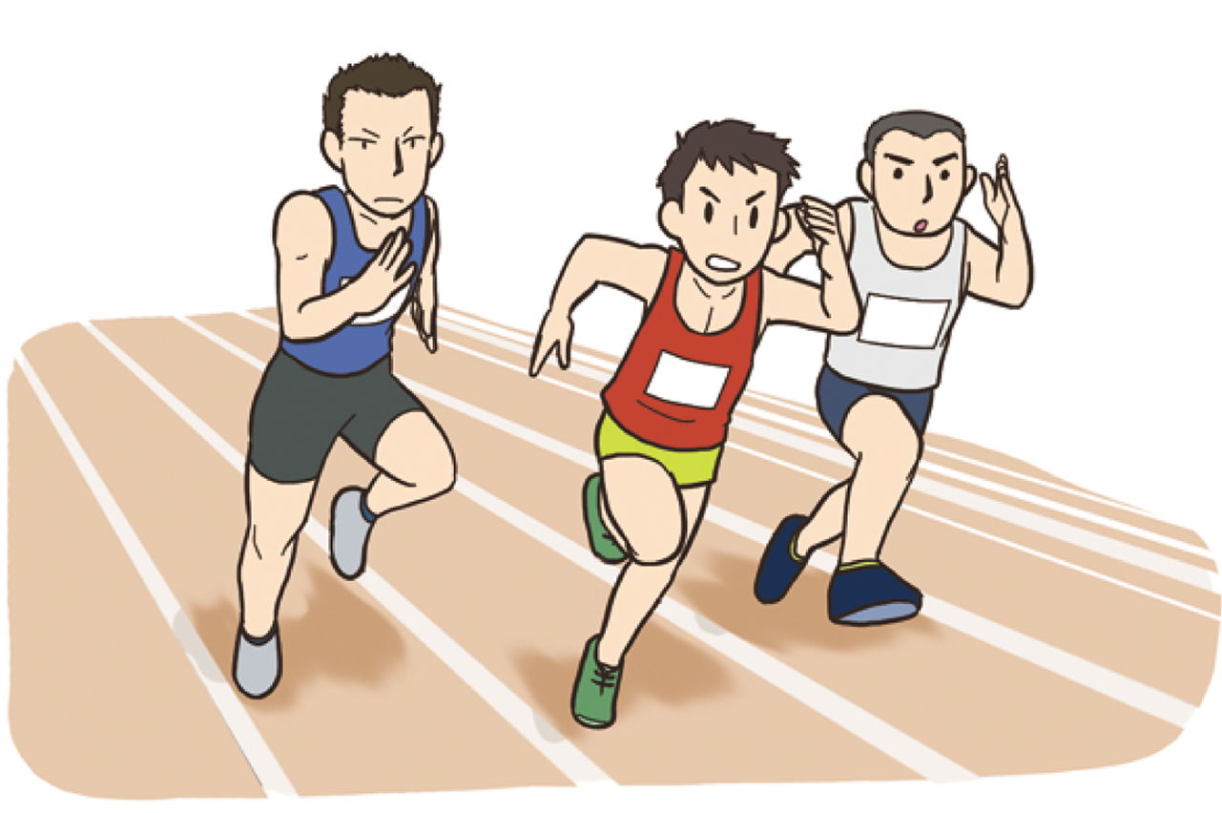

Slide 23


Slide 24


Slide 25

What is this job?
New Horizon 2
Stage Activity

Slide 26
What is this job?
help people in danger
take people to hospitals
fight a fire

Slide 27
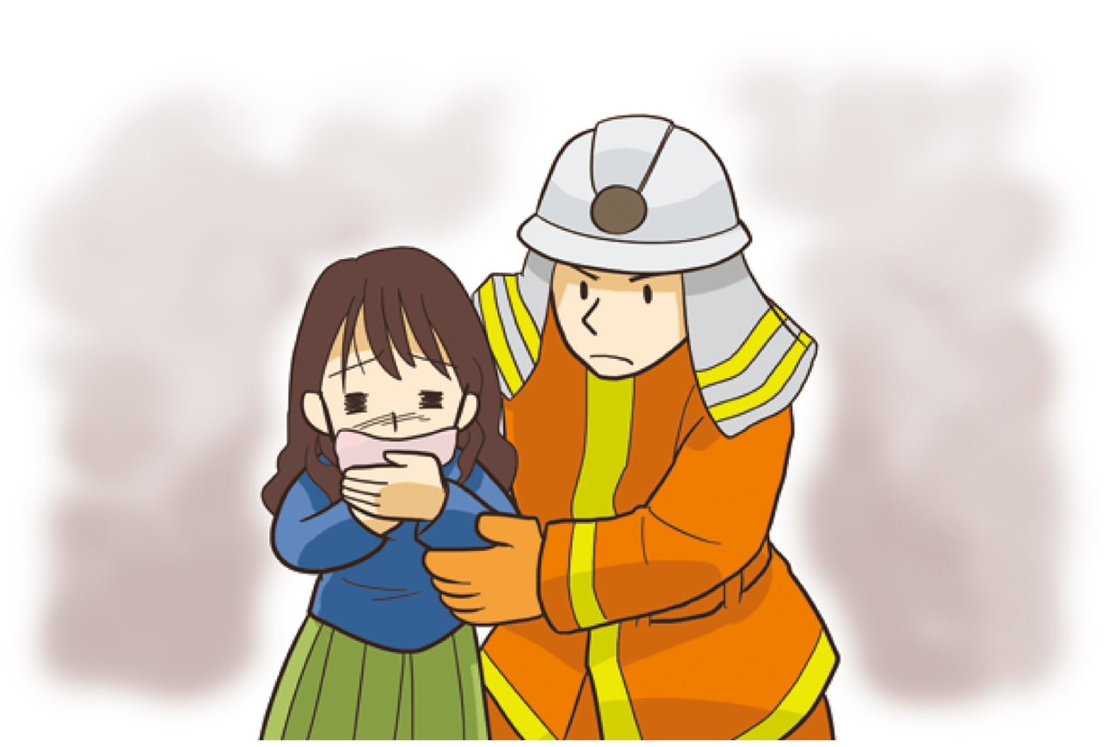

Slide 28
What is this job?
take care of sick people
work at hospitals
need to be careful

Slide 29
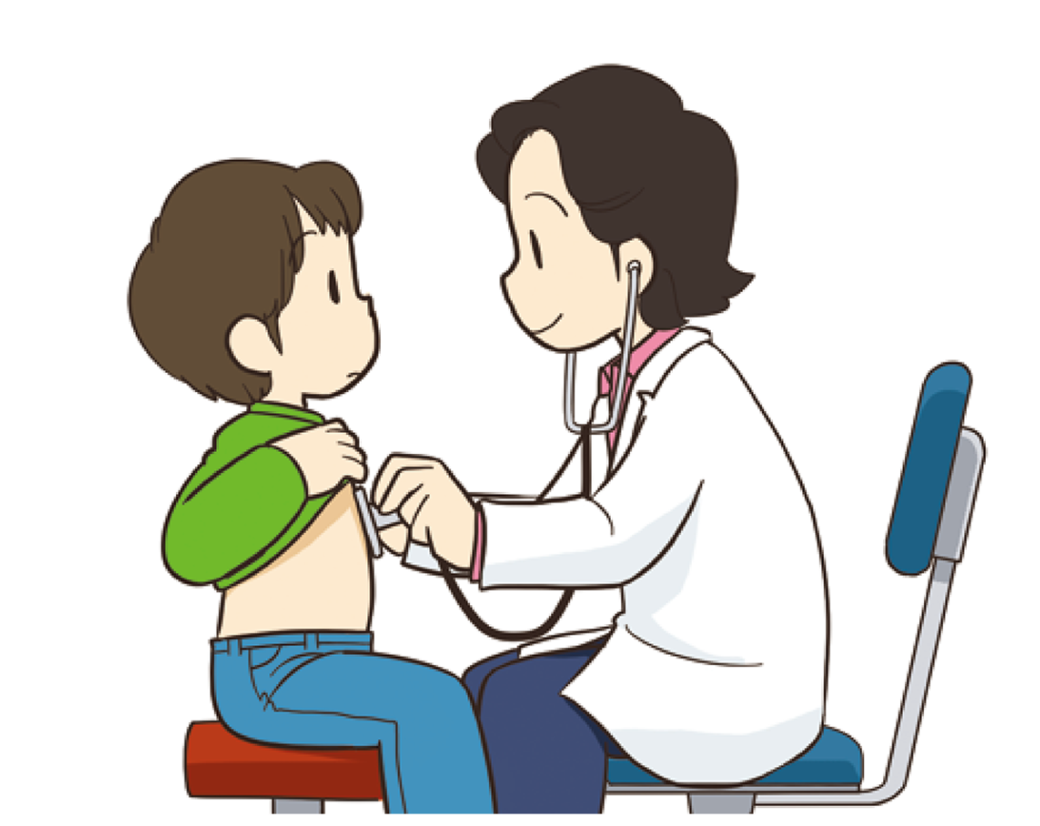

Slide 30
What is this job?
serve drinks and food
take care of passengers
work on airplanes

Slide 31
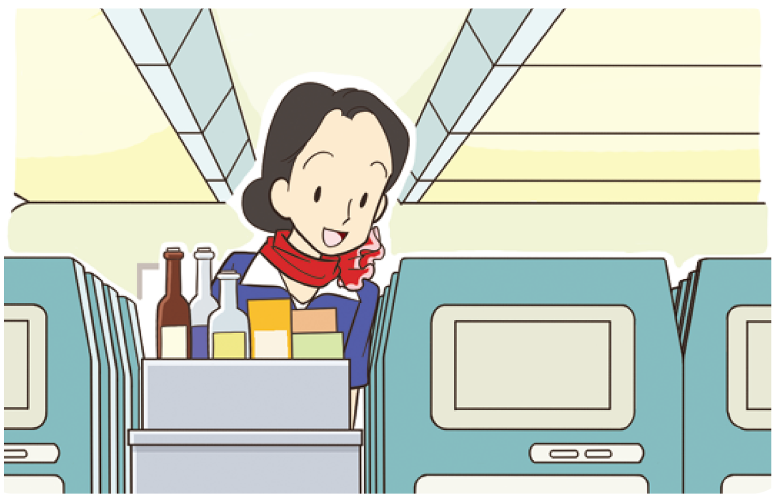

Slide 32
What is this job?
like to make something
need special technique
build houses

Slide 33
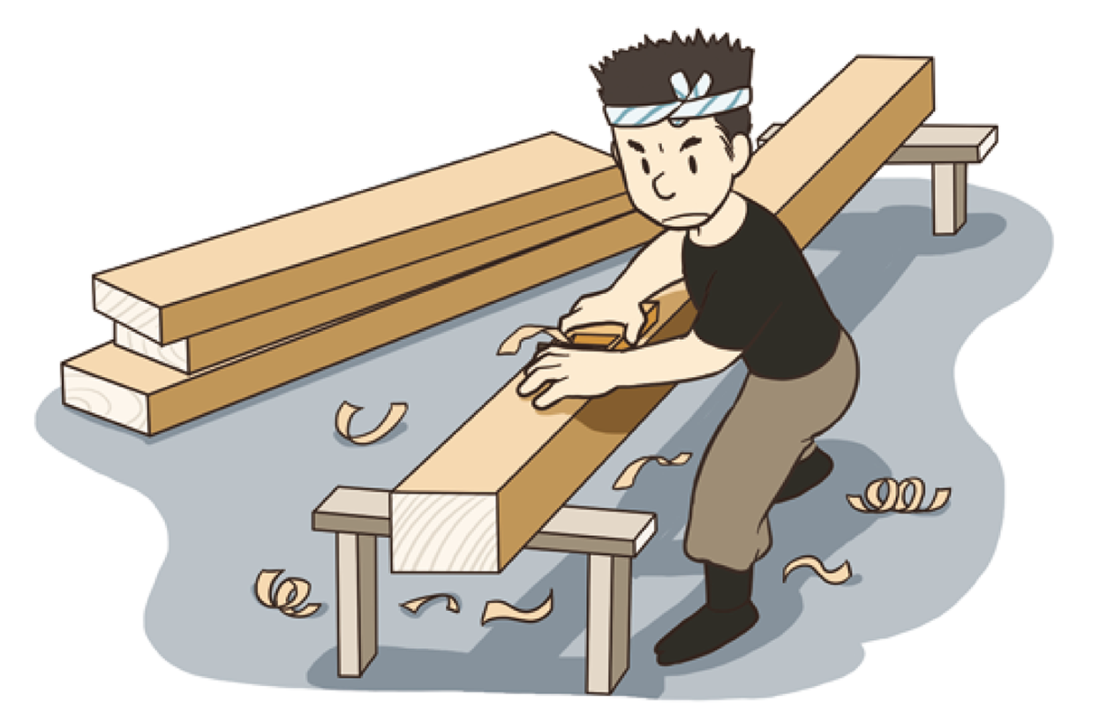

Slide 34
What is this job?
help old people
like to talk with people
very kind

Slide 35
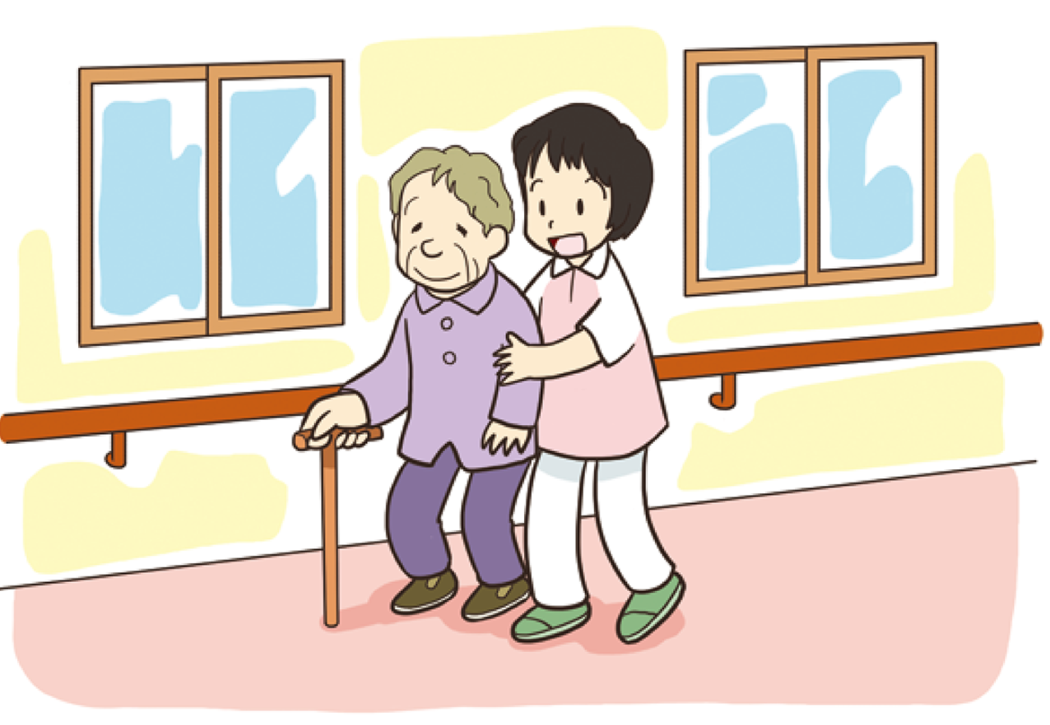

Slide 36
What is this job?
teach something at school
love children
Some teach sports, too.

Slide 37
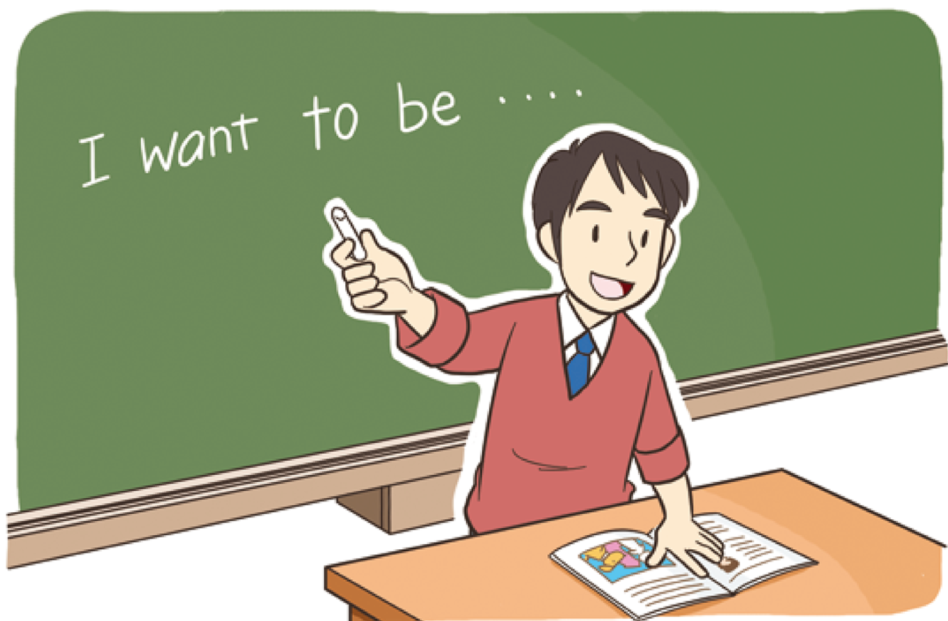

Slide 38
What is this job?
take care of animals
love animals
called animal doctor

Slide 39


Slide 40
Let’s think!
友達の良さや可能性を見つけるために
どんな質問をしたらいいのだろう？

Slide 41
I like sports.

Slide 42
I’m interested in computers.

Slide 43
My favorite food is ramen.

Slide 44
It’s interesting to take pictures.

Slide 45
I want more money.

Slide 46
I’m interested in computers.

Slide 47
I’m good at painting.

Slide 48
My favorite animal is panda.

Slide 49
It’s fun to go shopping.

Slide 50
I want to visit Kyoto.

Slide 51
I’m good at singing.

Slide 52
I’m interested in history.

Slide 53
It’s fun to talk with people.

Slide 54
I’m interested in foreign cultures.

Slide 55
It’s fun to make something.

