Slide 1
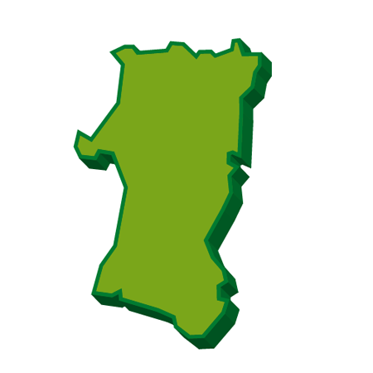
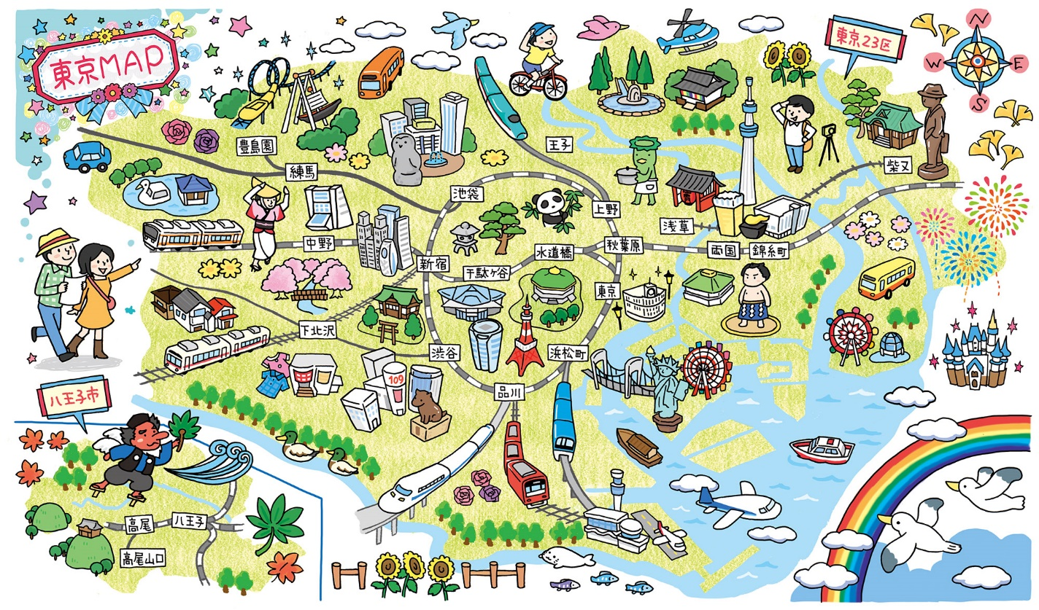
Which is good?
hyper-link version
Living in Akita
Living in a big city

Slide 2
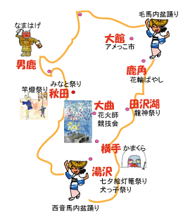
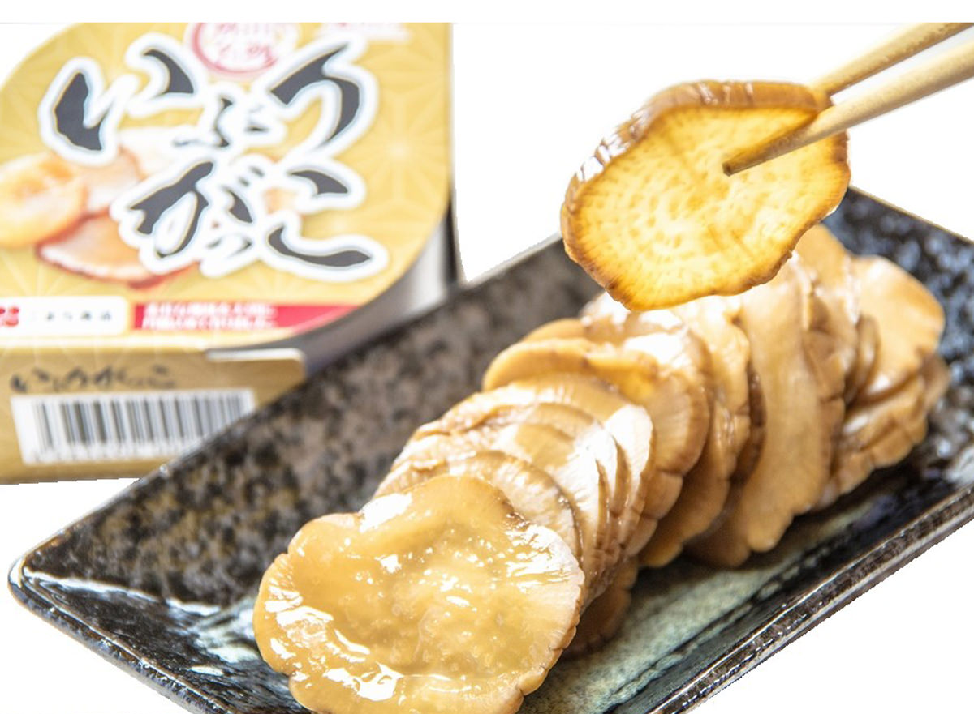
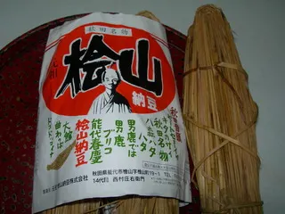
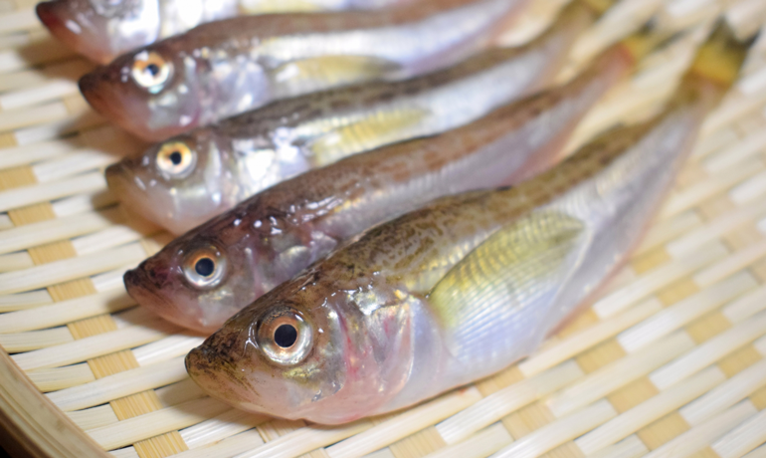
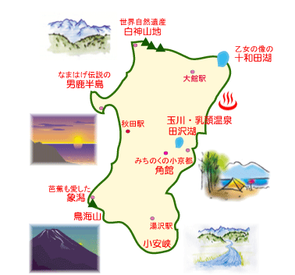
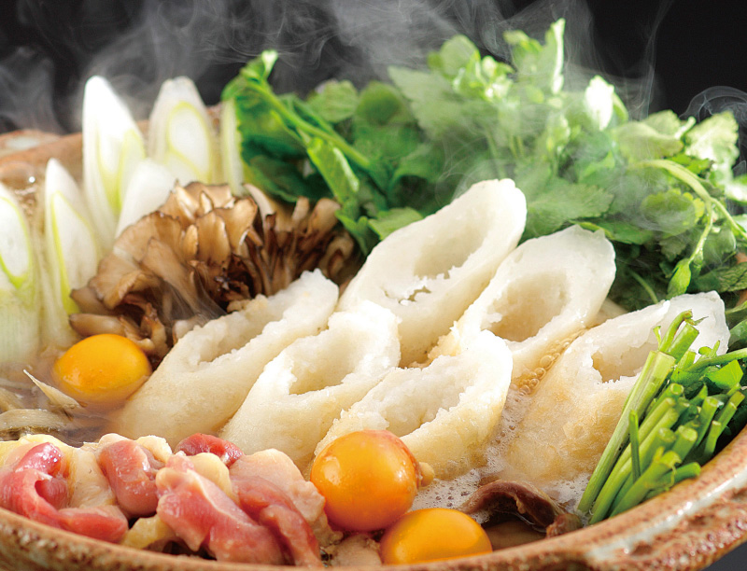
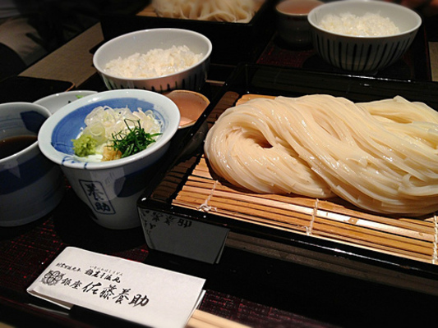
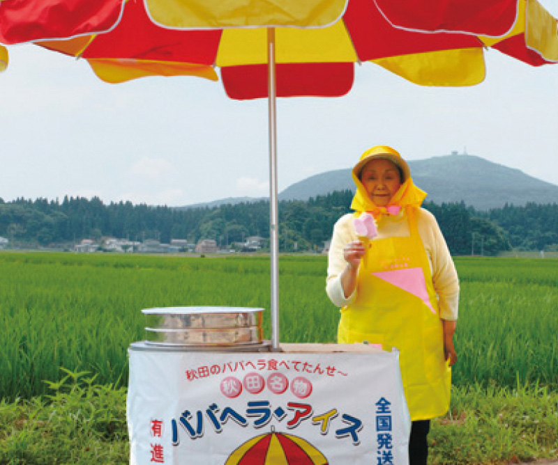
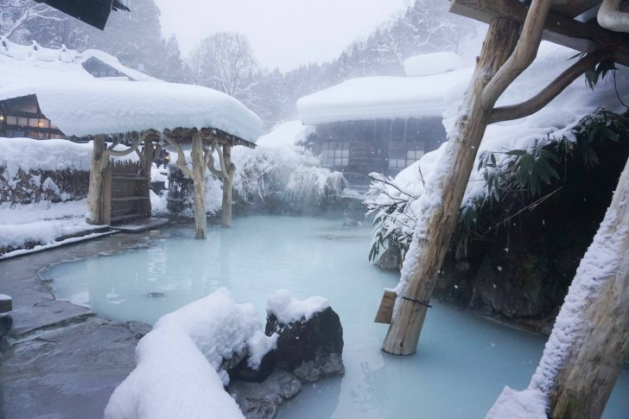
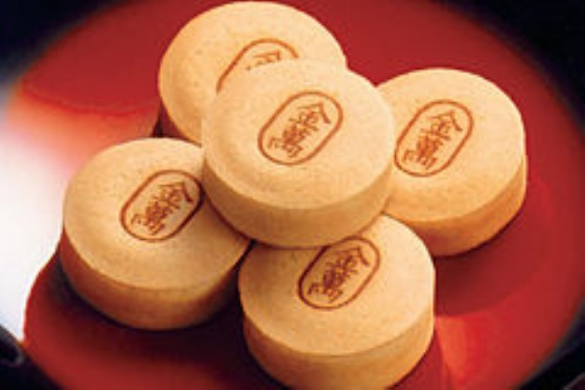
Let’s write!

Slide 3
Living in Akita is good because …
～がある There is(are) ～. / We have ～.
～を楽しめる We can enjoy ～.
～が大好き I love ～.
～することは簡単（楽しい） It is easy(fun) for us to ～.
Odate
Omagari
Yokote
Yuzawa
Shirakami Mountains
Mt. Chokai
Lake Towada
Lake Tazawa
shop / restaurants
temple /shrine
zoo / aquarium
Komachi stadium
onsen (hot springs)
fire works
kanto / namahage
festival
Ice candy / Baba-hera
smoked radish
/ Iburi-gakko
Kiritanpo-nabe
Inaniwa-udon
Hata-hata
Geopark
rice
MENU

Slide 4
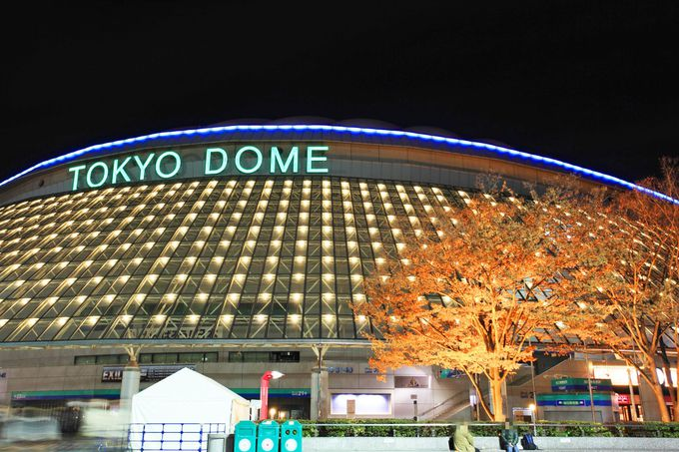
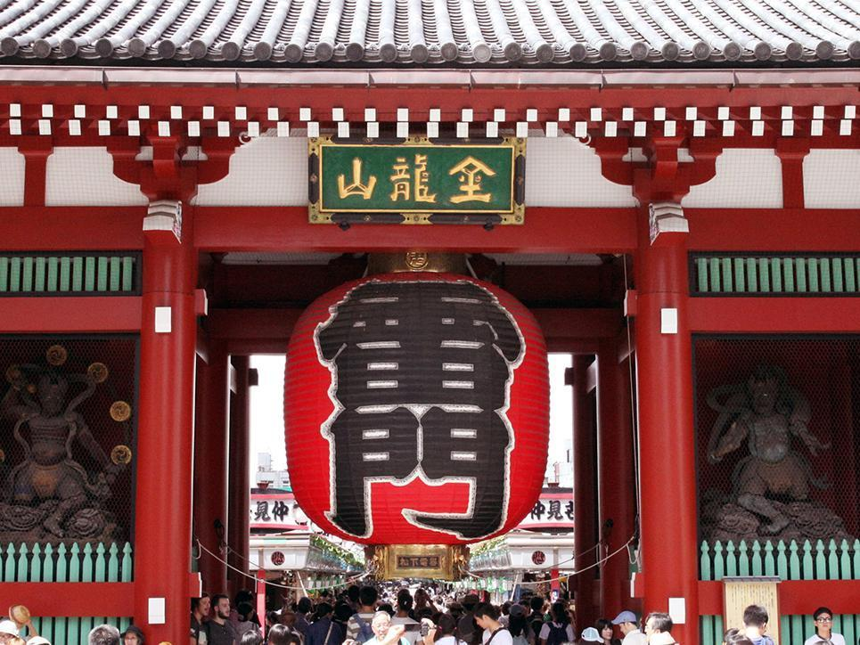

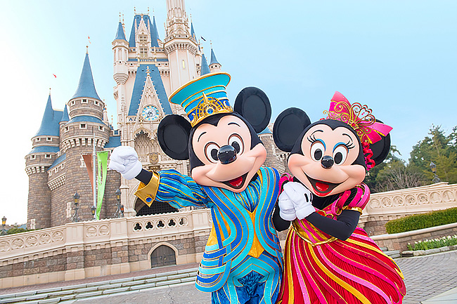
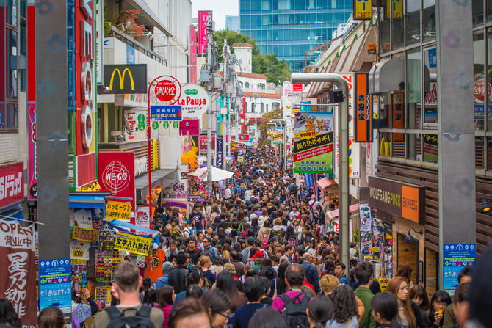
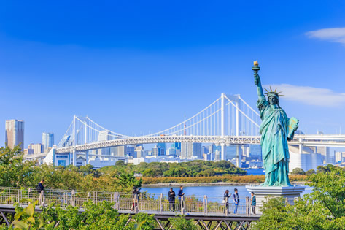
Let’s write!

Slide 5
Living in a big city is good because …
～がある There is(are) ～. / We have ～.
～を楽しめる We can enjoy ～.
～が大好き I love ～.
～することは簡単（楽しい） It is easy(fun) for us to ～.
Asakusa
Shibuya / Harajuku
Tokyo Skytree
Disneyland
Disney Sea
Ueno
Tokyo Dome
shop
restaurants
temple /shrine
zoo / aquarium
ballpark / stadium
amusement park
attractions
shopping
concert
baseball games
foreign food
night view
train / subway
MENU

Slide 6
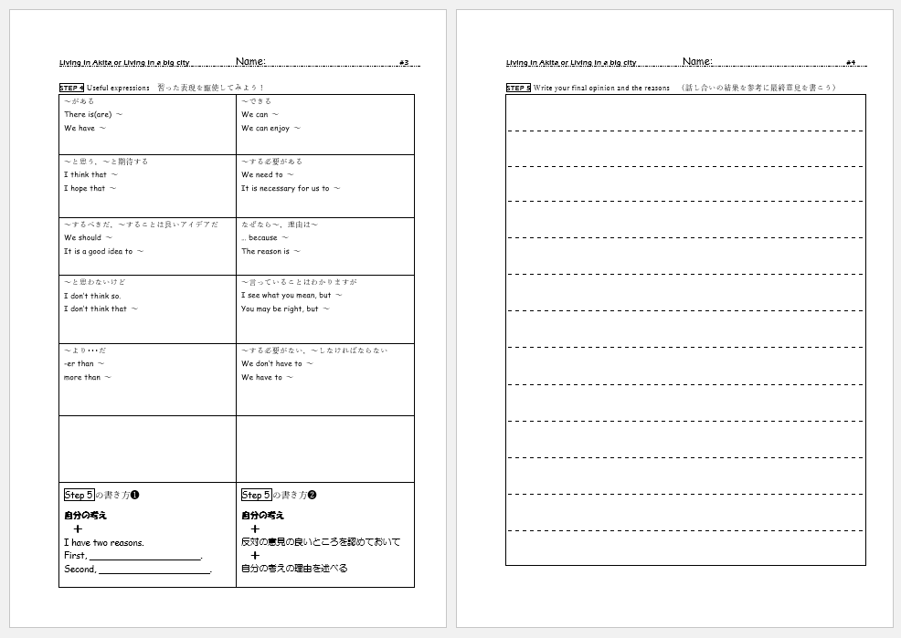

Slide 7
