Slide 1
What is
Paragraph Writing?

Slide 2

文章の構成

Slide 3
長い文章の構成
序論
導入
Introduction
本論
本文
Body
結論
まとめ
Conclusion

Slide 4
長い文章の構成
序論
導入
Introduction
本論
本文
Body
❶ 第１パラグラフ
❷ 第２パラグラフ
．．．
結論
まとめ
Conclusion

Slide 5
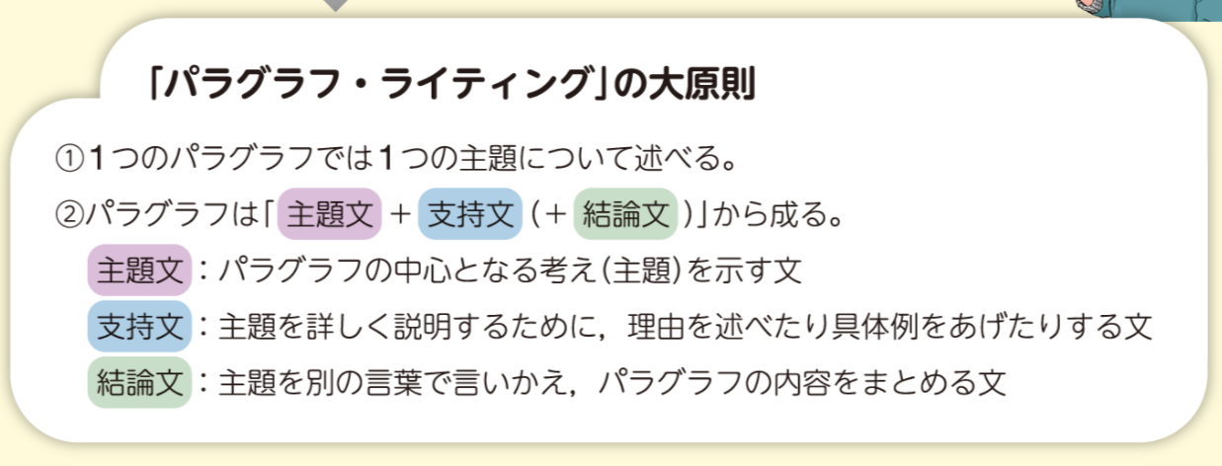

Slide 6
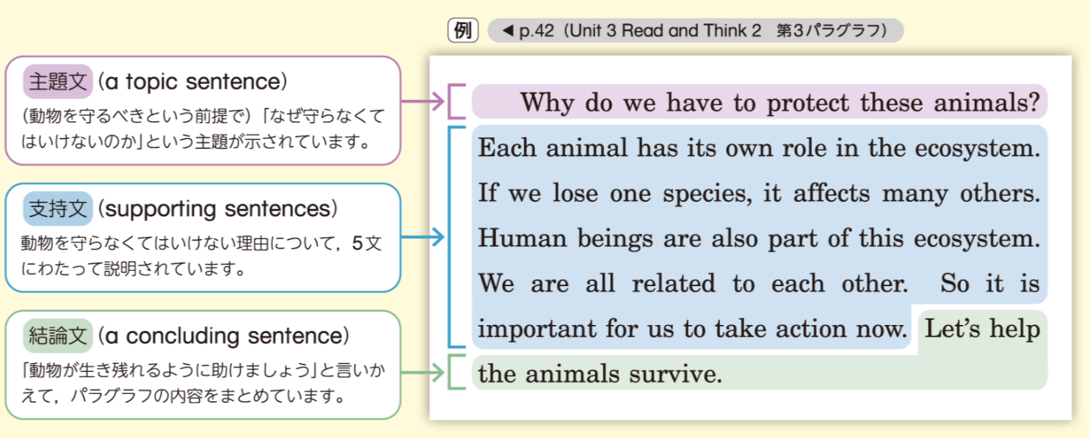

Slide 7
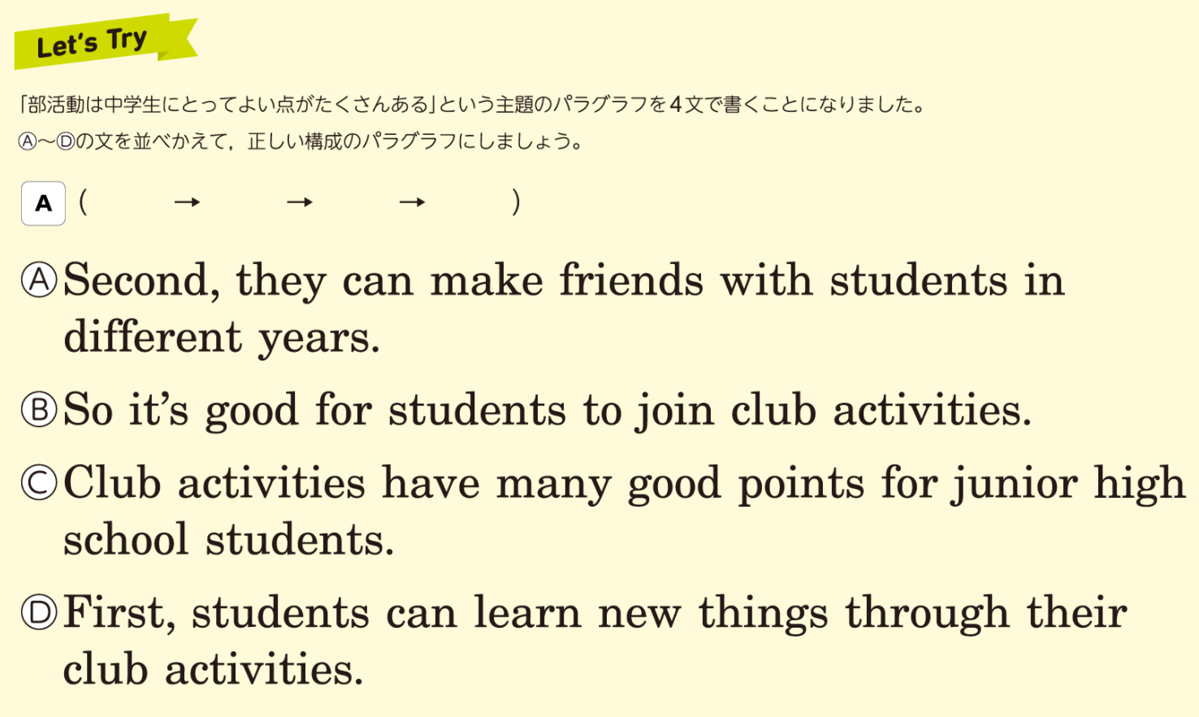

Slide 8
展開を広げるキーワード（接続詞）
and
but
or
so
when
before
after
while
till, until
if
because
though, although
that
however
both … and ～
not only … but also ～
so … that ～
I think that …
I hope that …

Slide 9
What is the Paragraph Writing?
導 入 Solar Cooker って何？
本 文 ① 発展途上国におけるSolar Cooker の３つの利点
② Solar Cooker と環境問題
③ Renewable Energy の可能性
まとめ ？ ＿

Slide 10
concluding sentence を完成させよう！
A solar cooker is a tool to heat food in a pot.
It uses solar power, and it has many good points. First, making a solar cooker does not cost much. We can make one with only cardboard and aluminum foil. Second, people in developing countries can get cleaner water by boiling it with a solar cooker. Drinking water from rivers and lakes is one of the biggest causes of disease. Third, a solar cooker is safe because it does not make smoke. Lots of people in the world burn firewood indoors to cook. A lot of children die from its smoke.
I think that we ___________ _______ a solar cooker for the earth and the ___________ on the earth.

