Slide 1
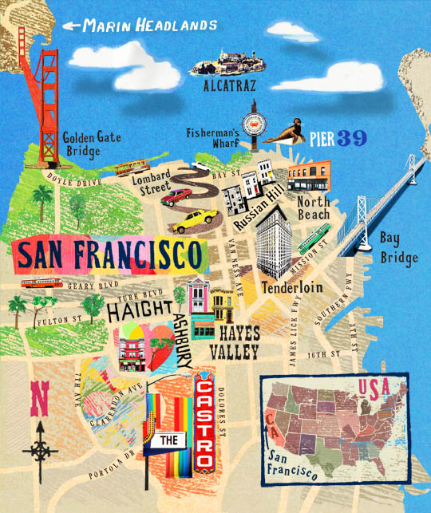
What is the name of this town?
Los Angeles
San Diego
San Francisco

Slide 2
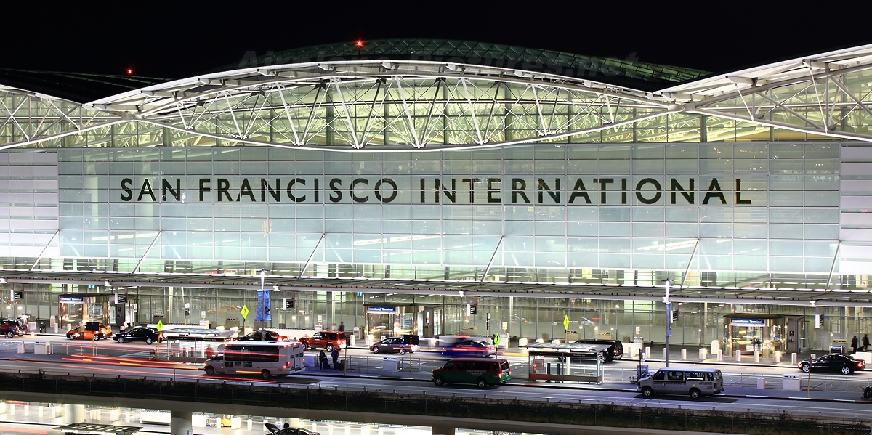
What is the S.F airport’s name?
San Francisco Airport
San Francisco International Airport
San Francisco Airplane

Slide 3
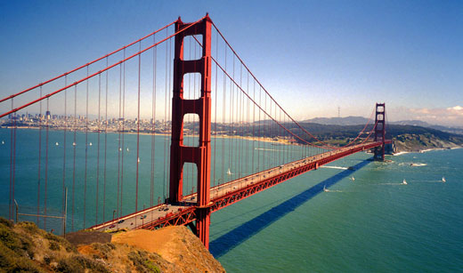
What famous bridge is in S.F?
Brooklyn Bridge
Golden Gate Bridge
Rainbow Bridge

Slide 4
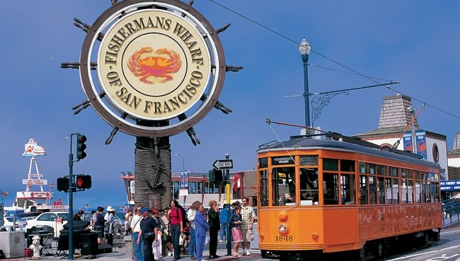
Where is this?
Aquarium
Fisherman’s Wharf
Ocean Park

Slide 5
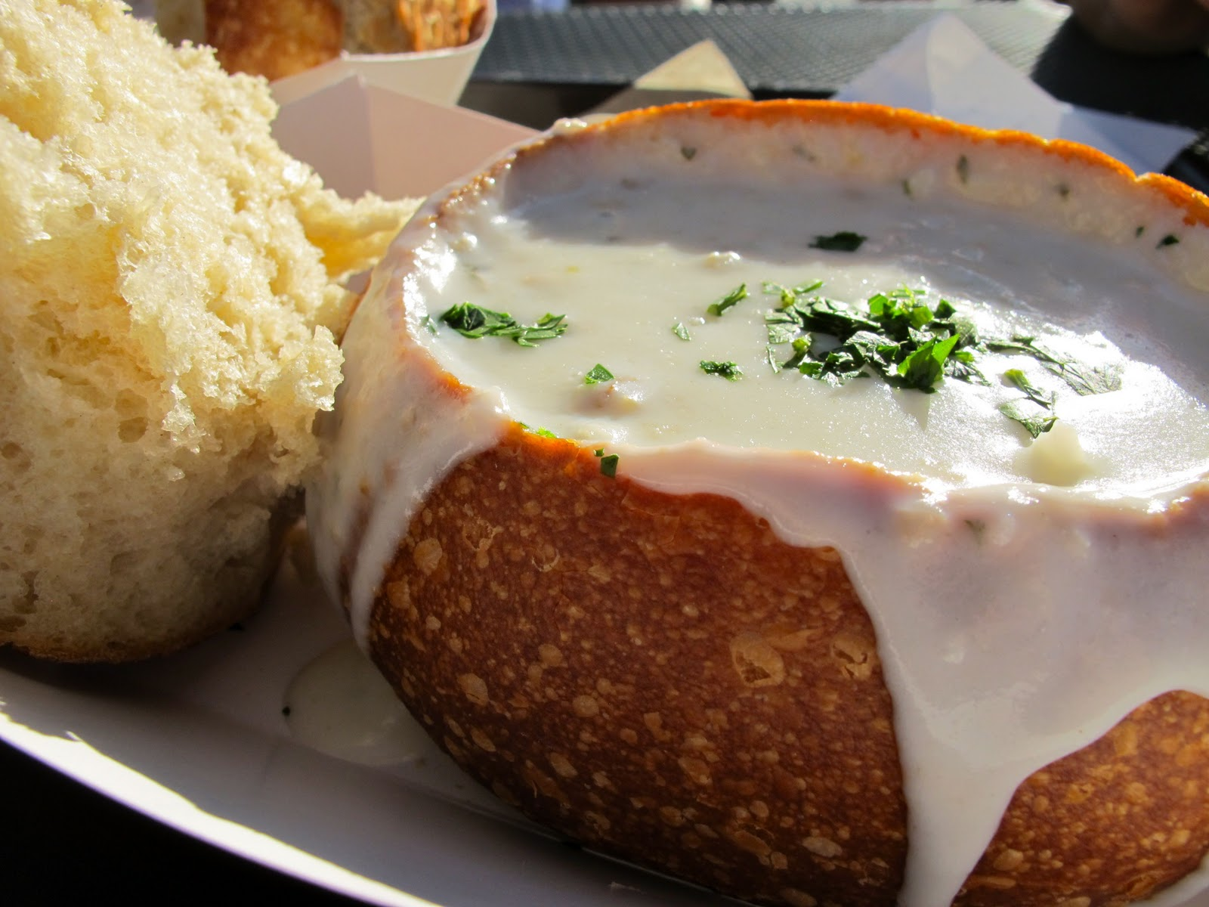
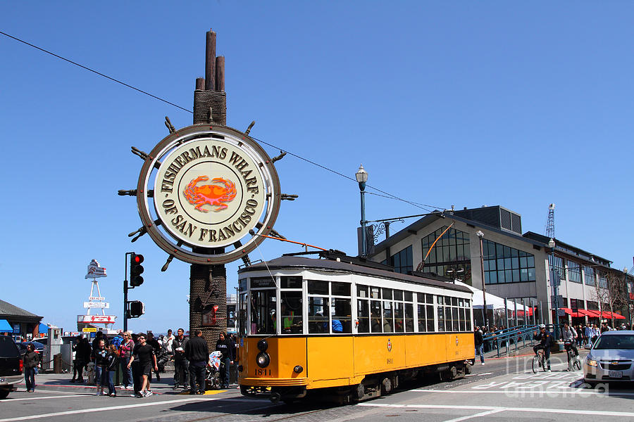
What famous food can you eat at Fisherman’s Wharf?
Clam Chowder
Salmon Bake
Sushi

Slide 6
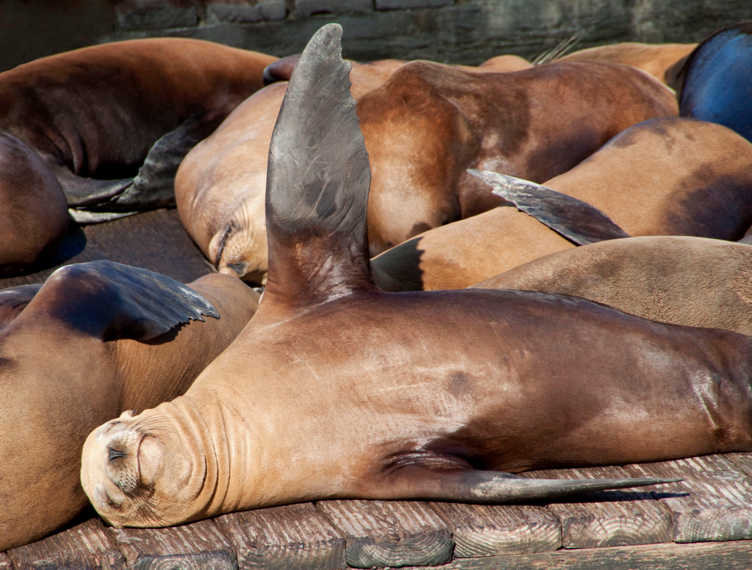
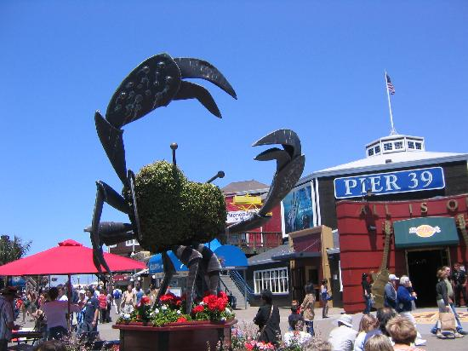
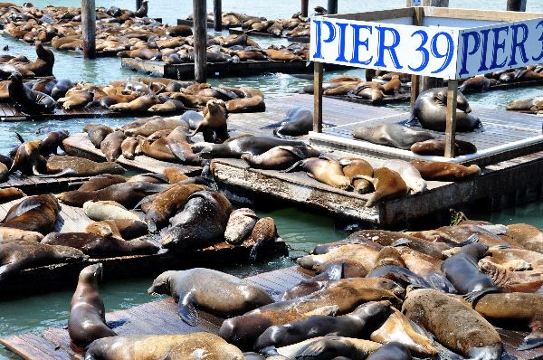
What animals can you see at Fisherman’s Wharf?
Sea Otters
Dolphins
Sea Lions

Slide 7
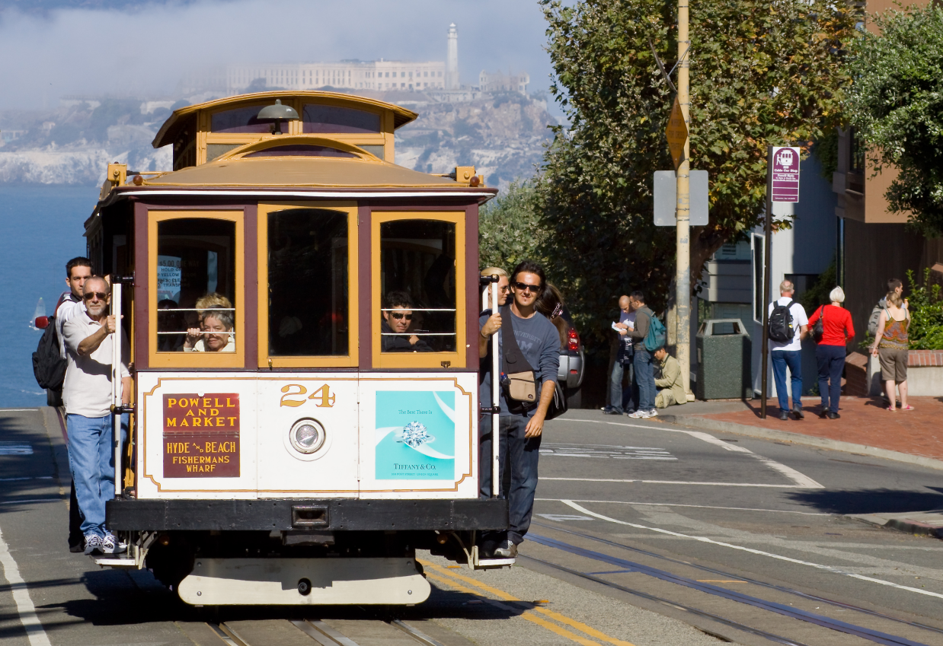
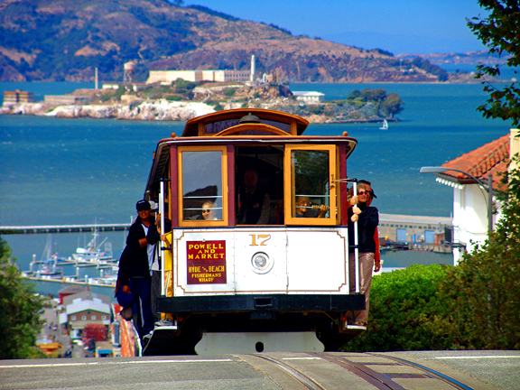
What can you ride in S.F?
Taxi
Trolley
Cable Car

Slide 8
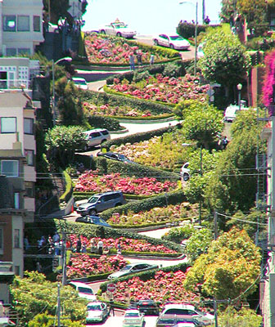
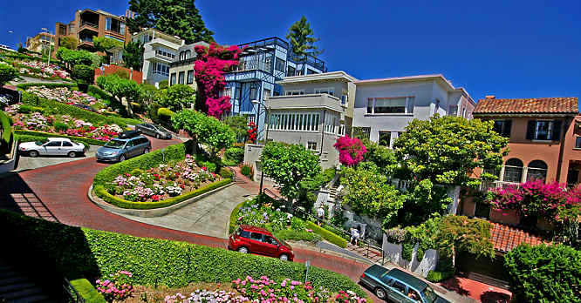
What famous road is in S.F?
Lombart Street
Main Street
First Street

Slide 9
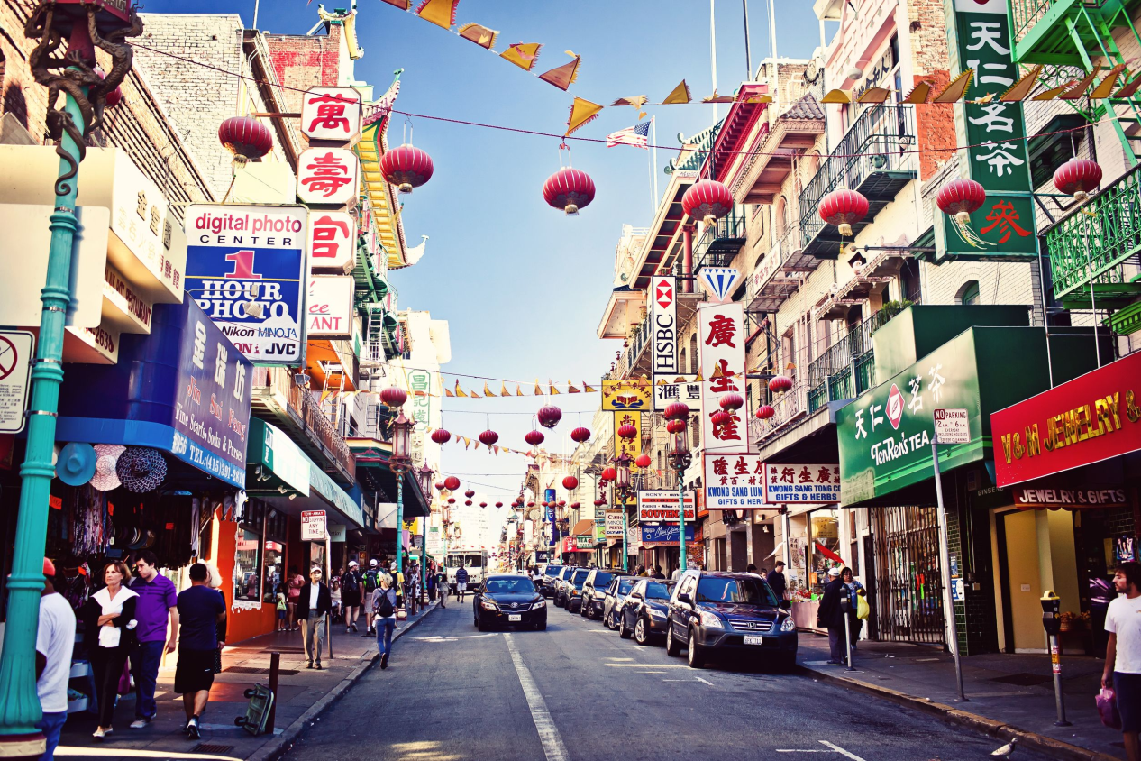
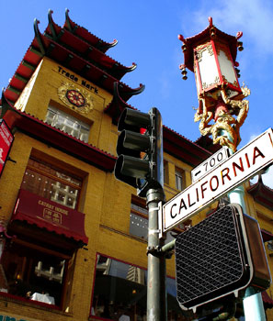
Where is this?
Main Street
City Hall
Chinatown

Slide 10
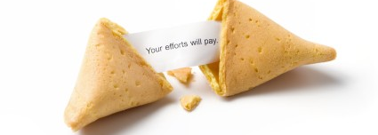
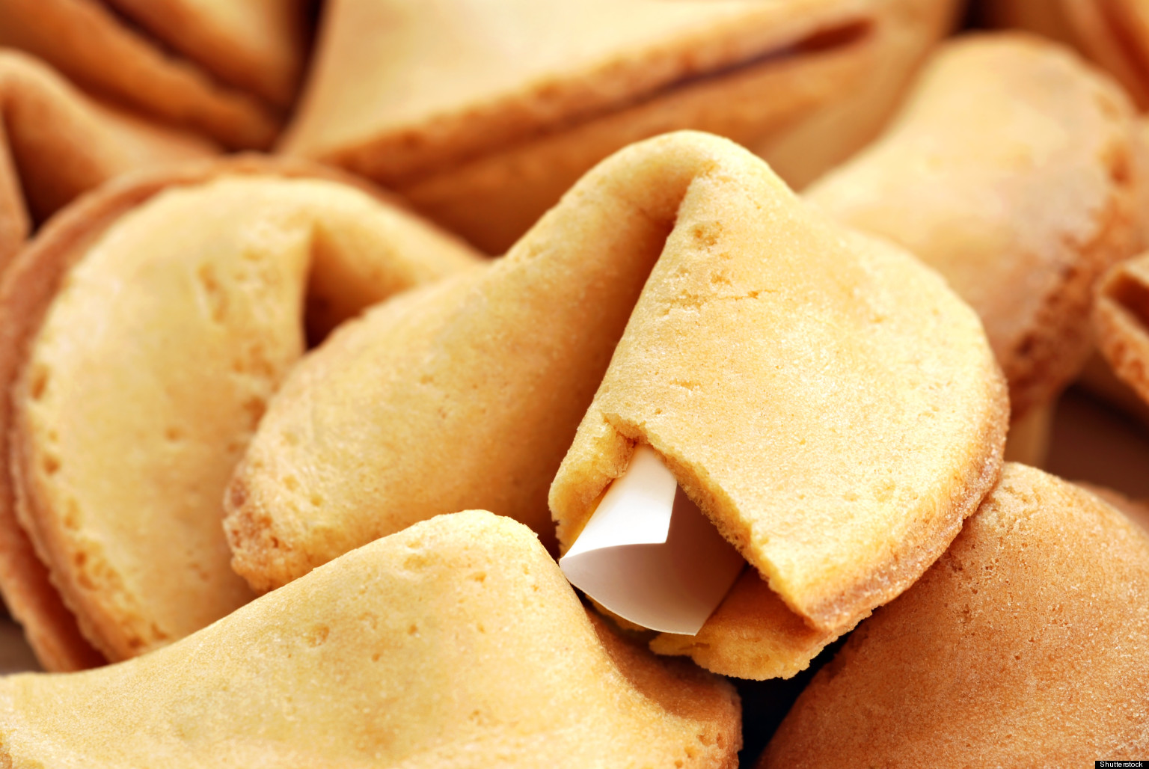
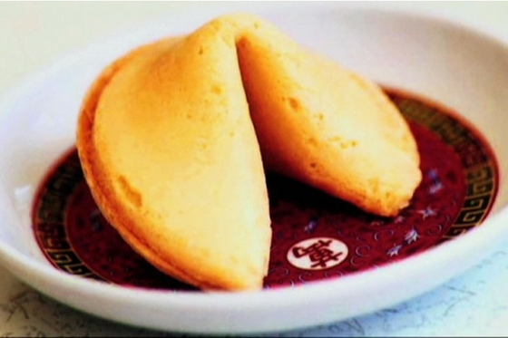
What can you eat in Chinatown?
Sushi
Fortune Cookies
Hamburger

Slide 11
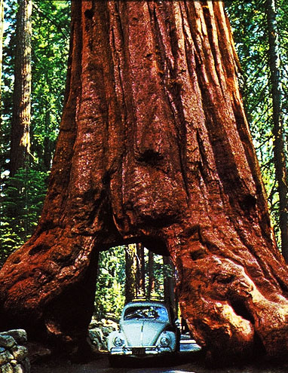
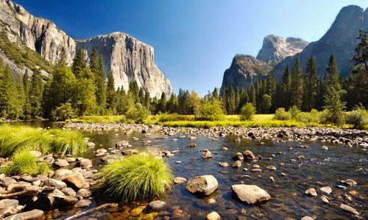
What National Park near S.F.?
Grand Canyon
Yosemite National Park
Yellowstone

Slide 12
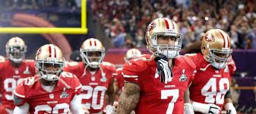
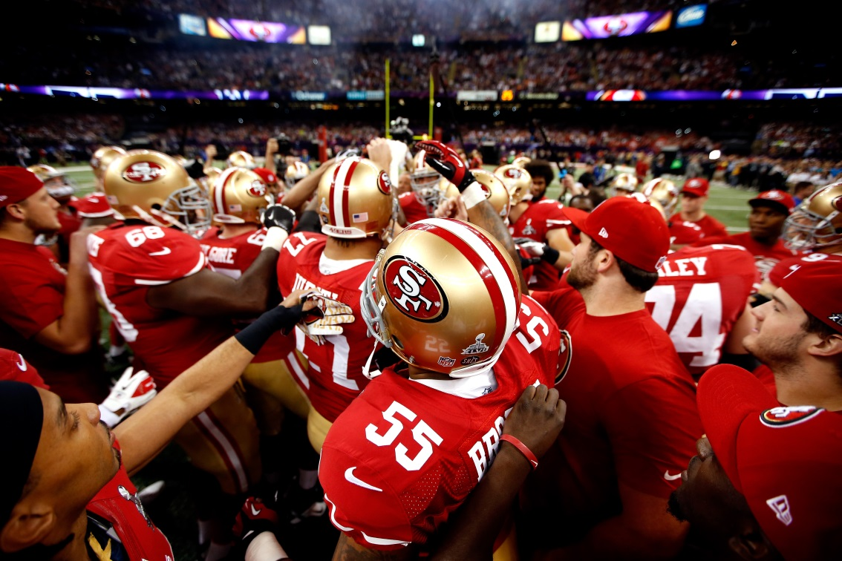
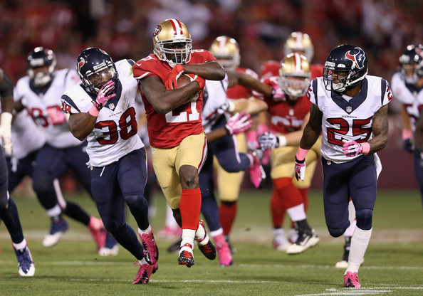
What football team is from S.F.?
Green Bay Packers
Seattle Seahawks
San Francisco 49ers

Slide 13
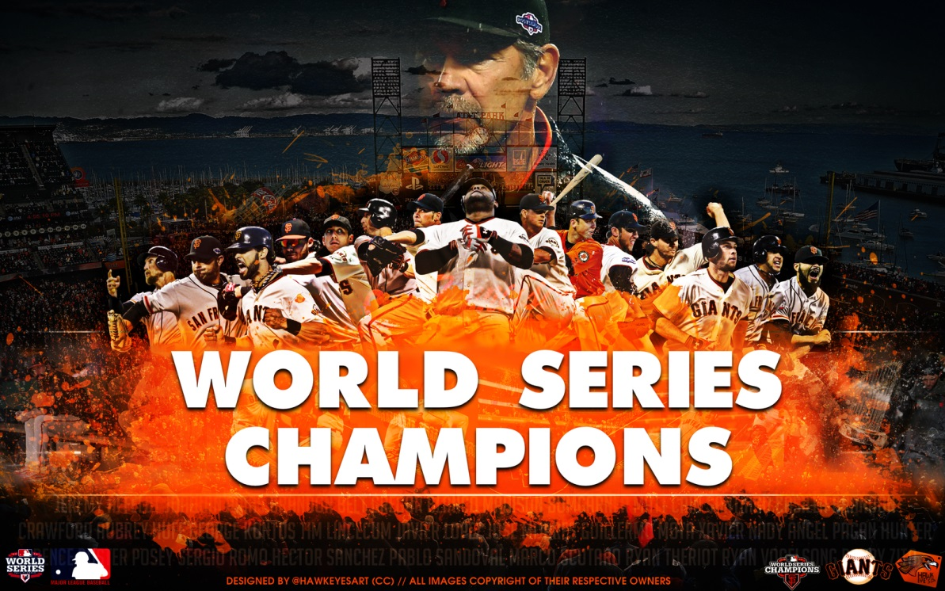
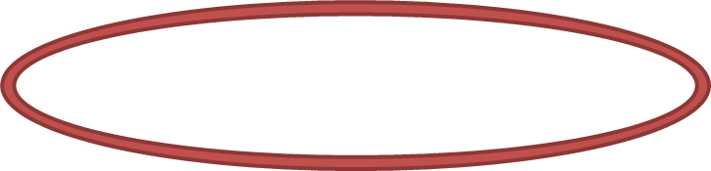
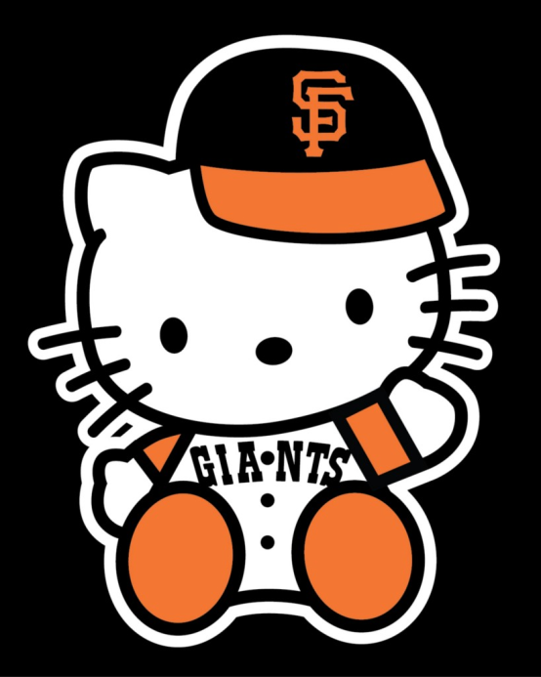
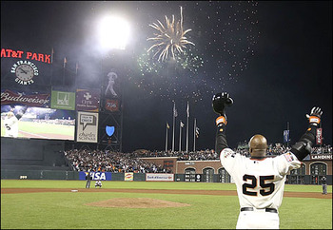
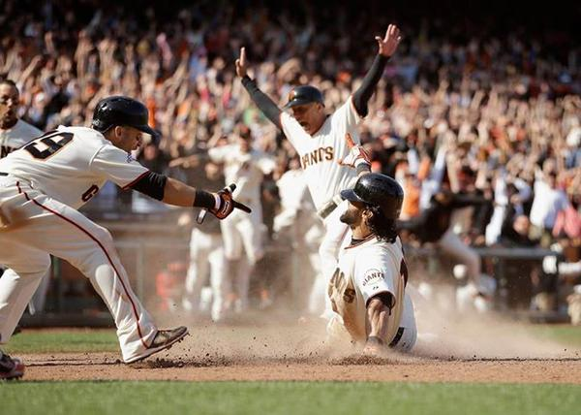
What baseball team is from S.F.?
Mariners
Giants
Yankees

